Slide 1
QC and analysis of four scRNA samples
Ccbr 1045

Slide 2
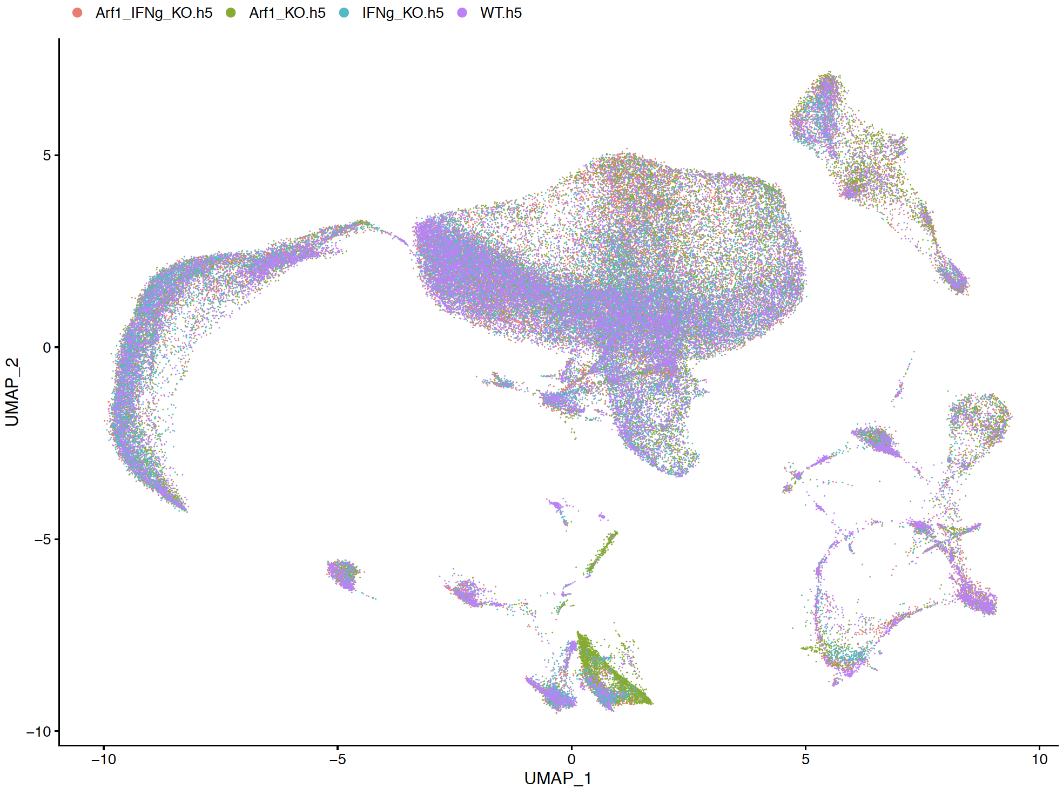
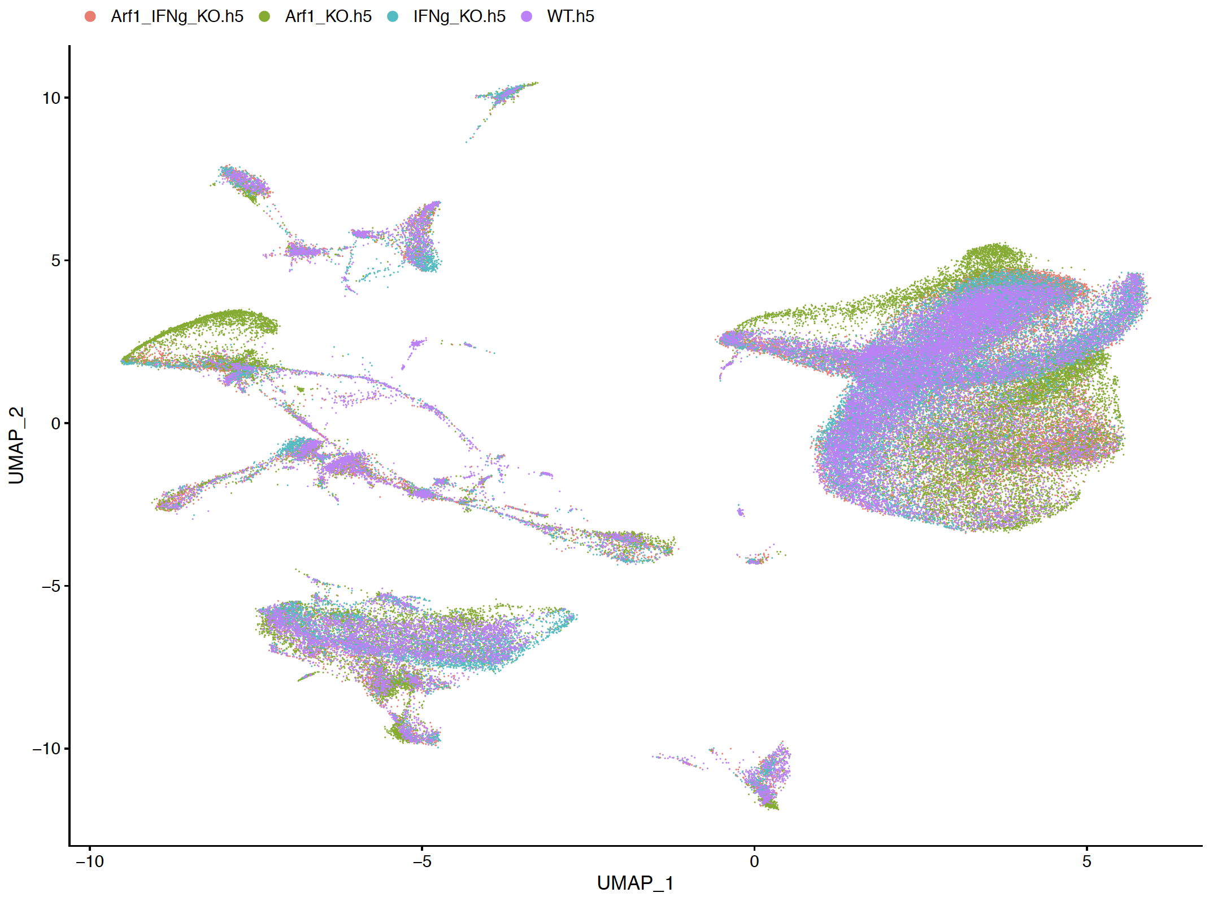
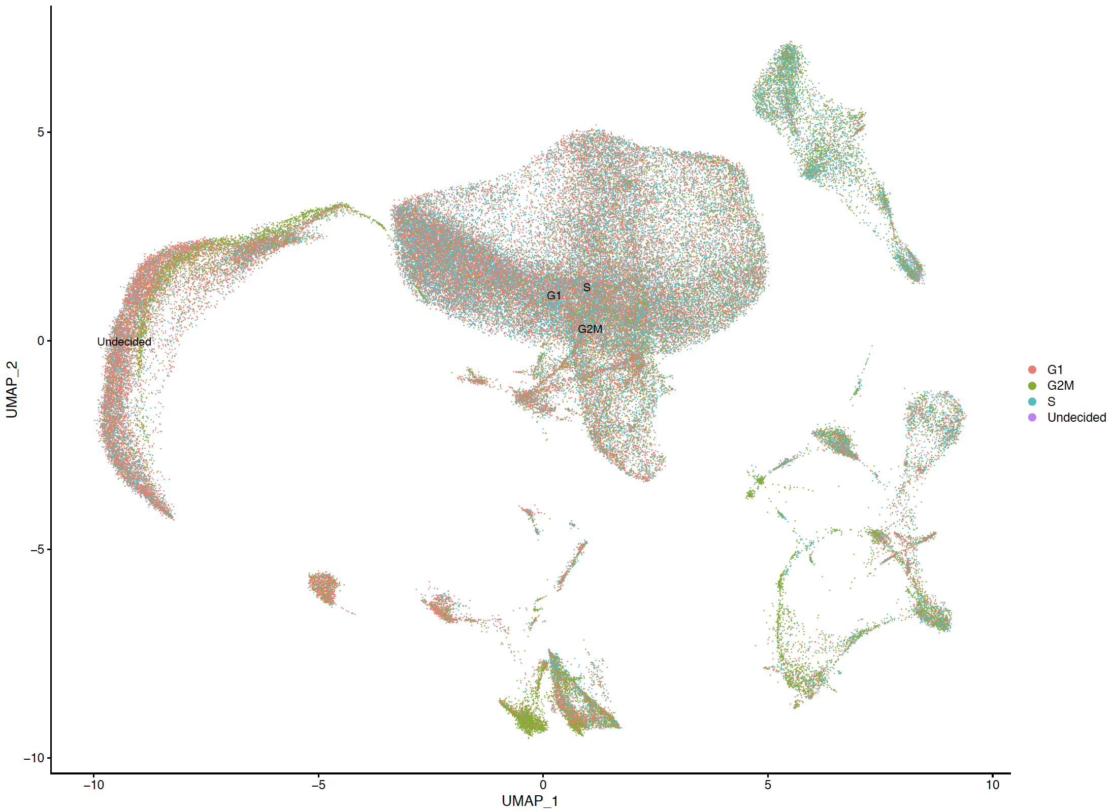
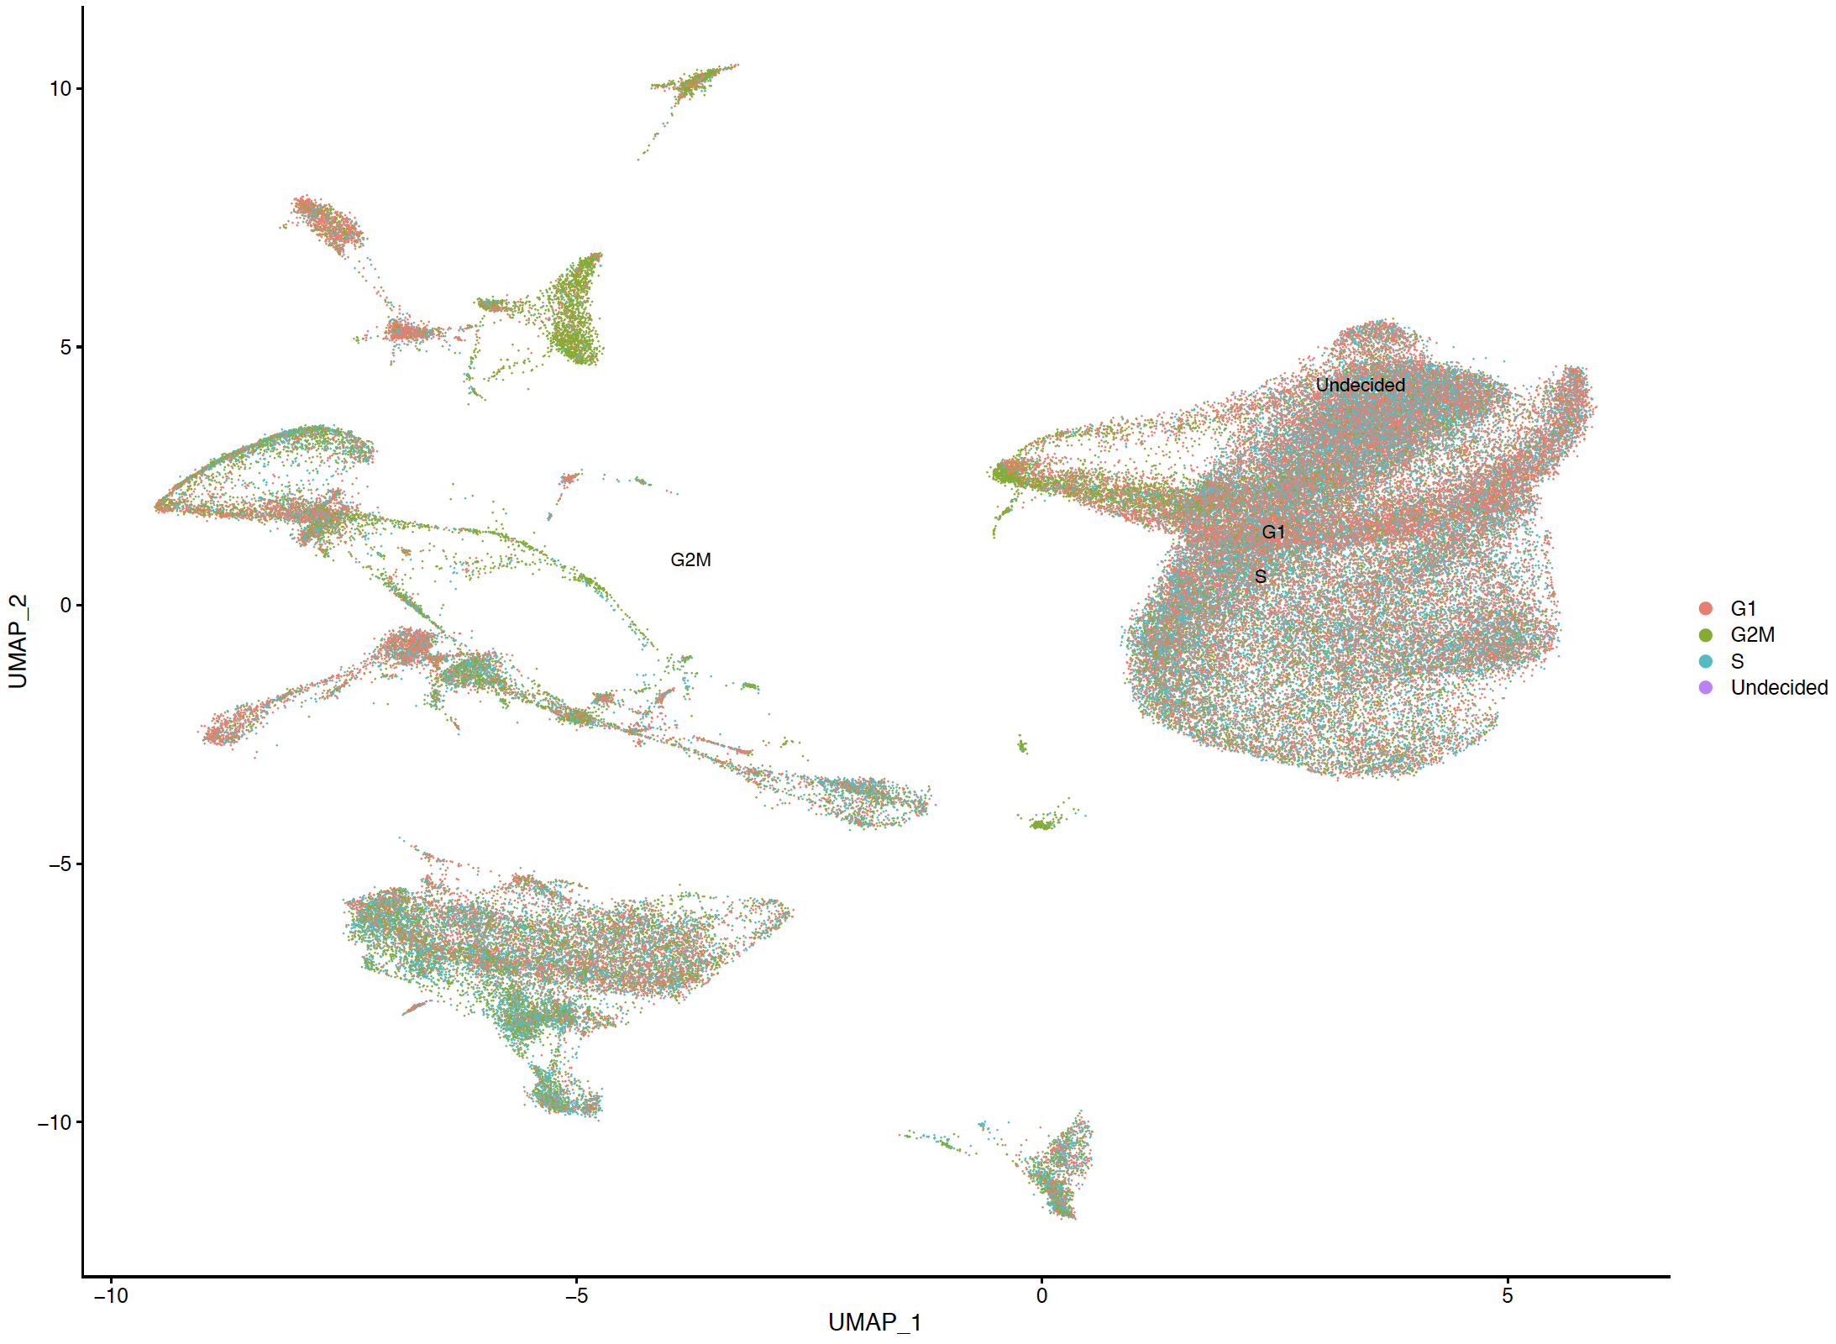
Before batch correction
Batch-corrected
Color by sample
Plotting all samples overlaid, colored by sample. Check to see if clustering behavior is tied to sample.
It looks like the four samples aren’t separated before or after, which is expected.
Color by cell cycle
Plotting all samples overlaid, colored by phase. Check to see if clustering behavior is tied to cell cycle.
It looks like the microglial cluster(main cluster) isn’t tied to cell cycle, good.

Slide 3
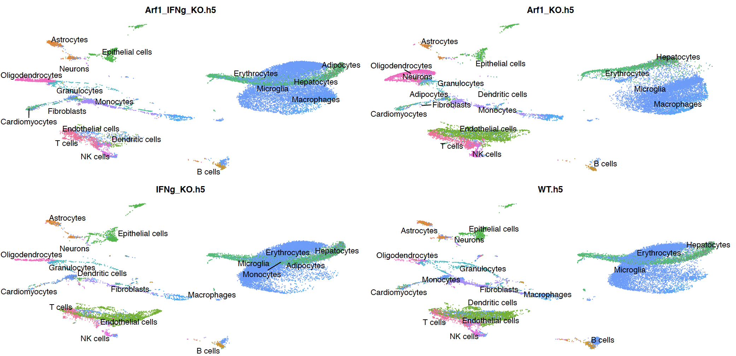
Before batch correction, group by mouseRNAseq_main

Slide 4
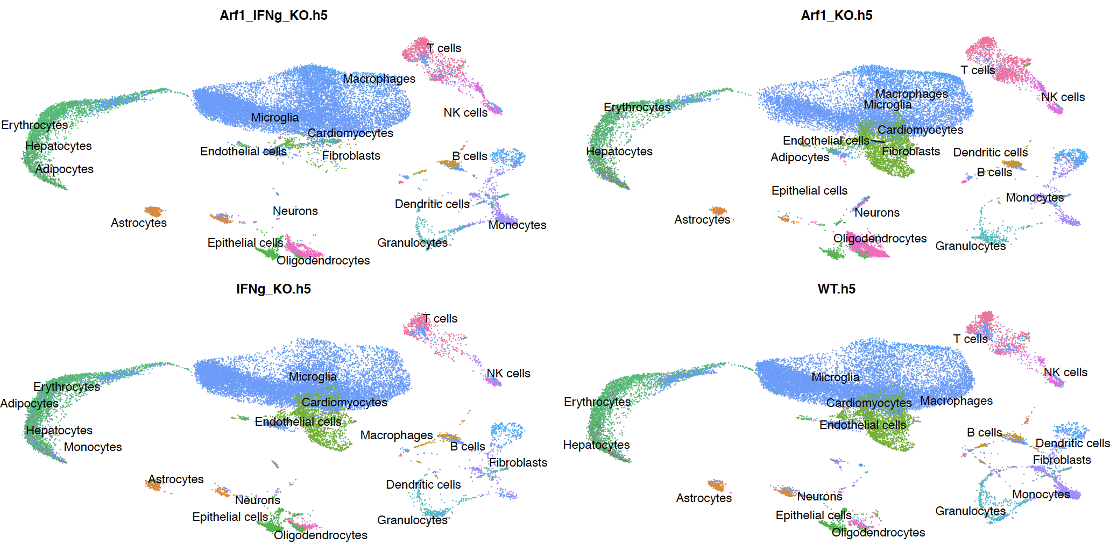
Batch-corrected, group by mouseRNAseq_main

Slide 5
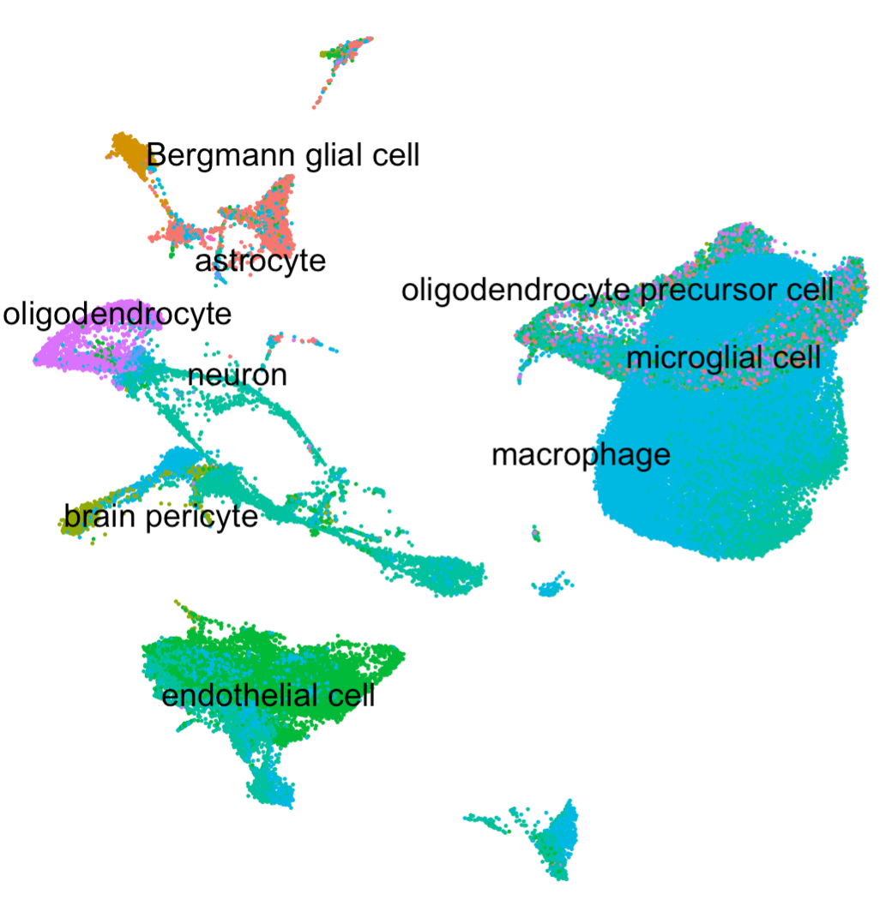
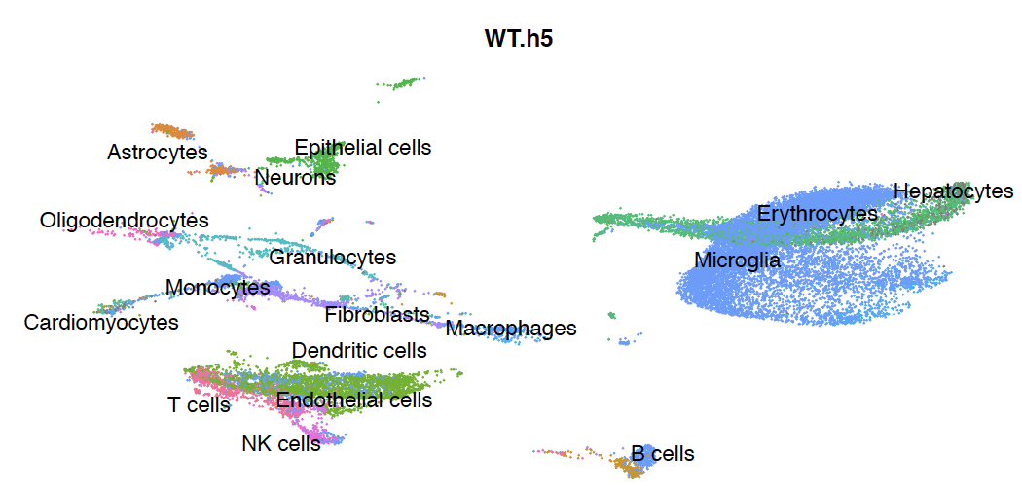
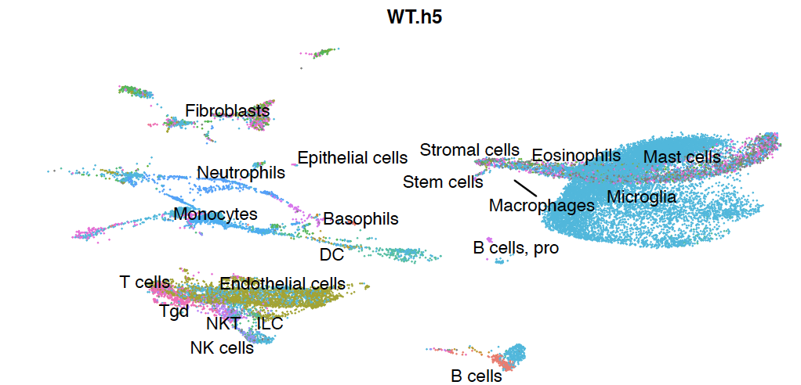
Comparison of cell identity annotation by three databases
Tabulus Muris
mouseRNAseq_main
Immgen_main
First, I checked to see which database is more accurate in assigning cell type by using FindMarkers. This is UMAP showing WT sample before batch correction. For cluster7, 9, 10,11, the top enriched genes are Hbb-bt, Hba-a1, Hba-a2, etc. all hemoglobin genes, indicating the cells in cluster7, 9, 10 represent red blood cells. This is accurately predicted by the mouseRNAseq_main as erythrocytes. In addition, mouseRNAseq_main also cluster23 as astrocytes correctly as the top enriched gene Aldoc is an astrocyte marker. Also mouseRNAseq_main predicted cluster15 as Oligodendrocytes, which is has high Plp1 expression(Oligodendrocytes marker).

Slide 6
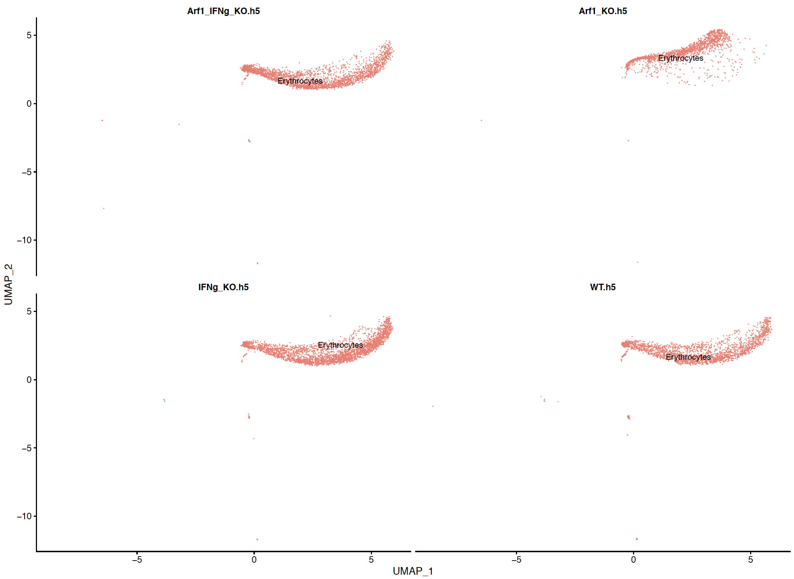
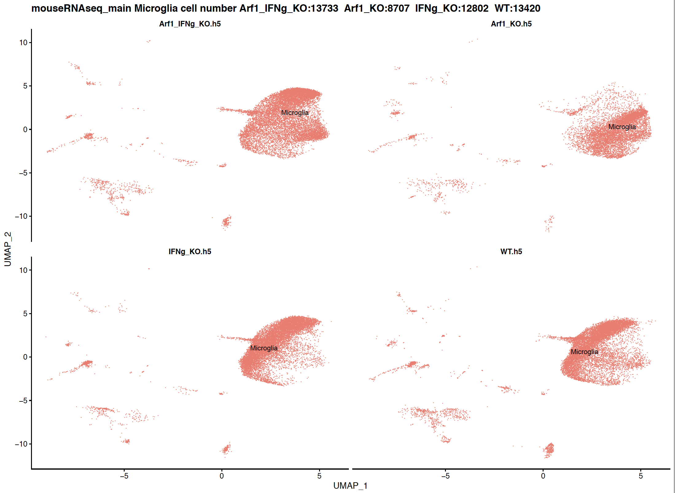
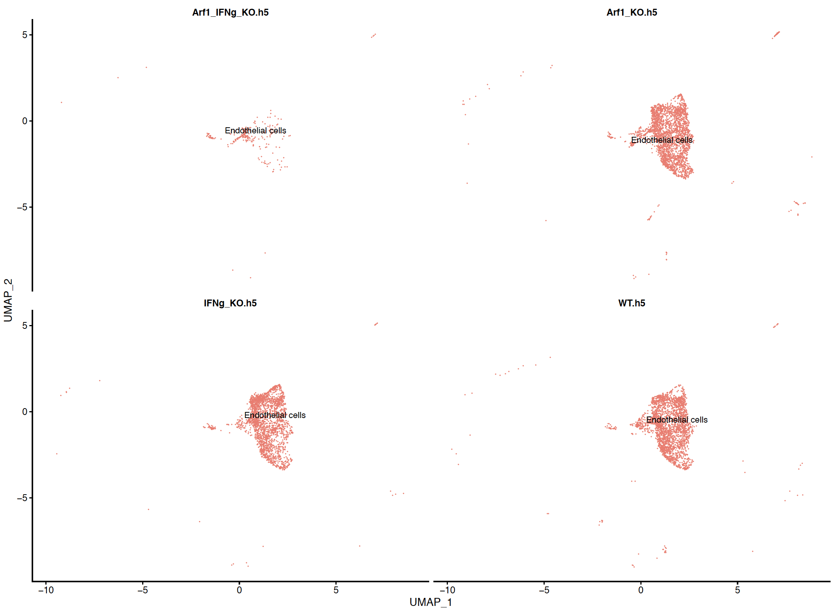
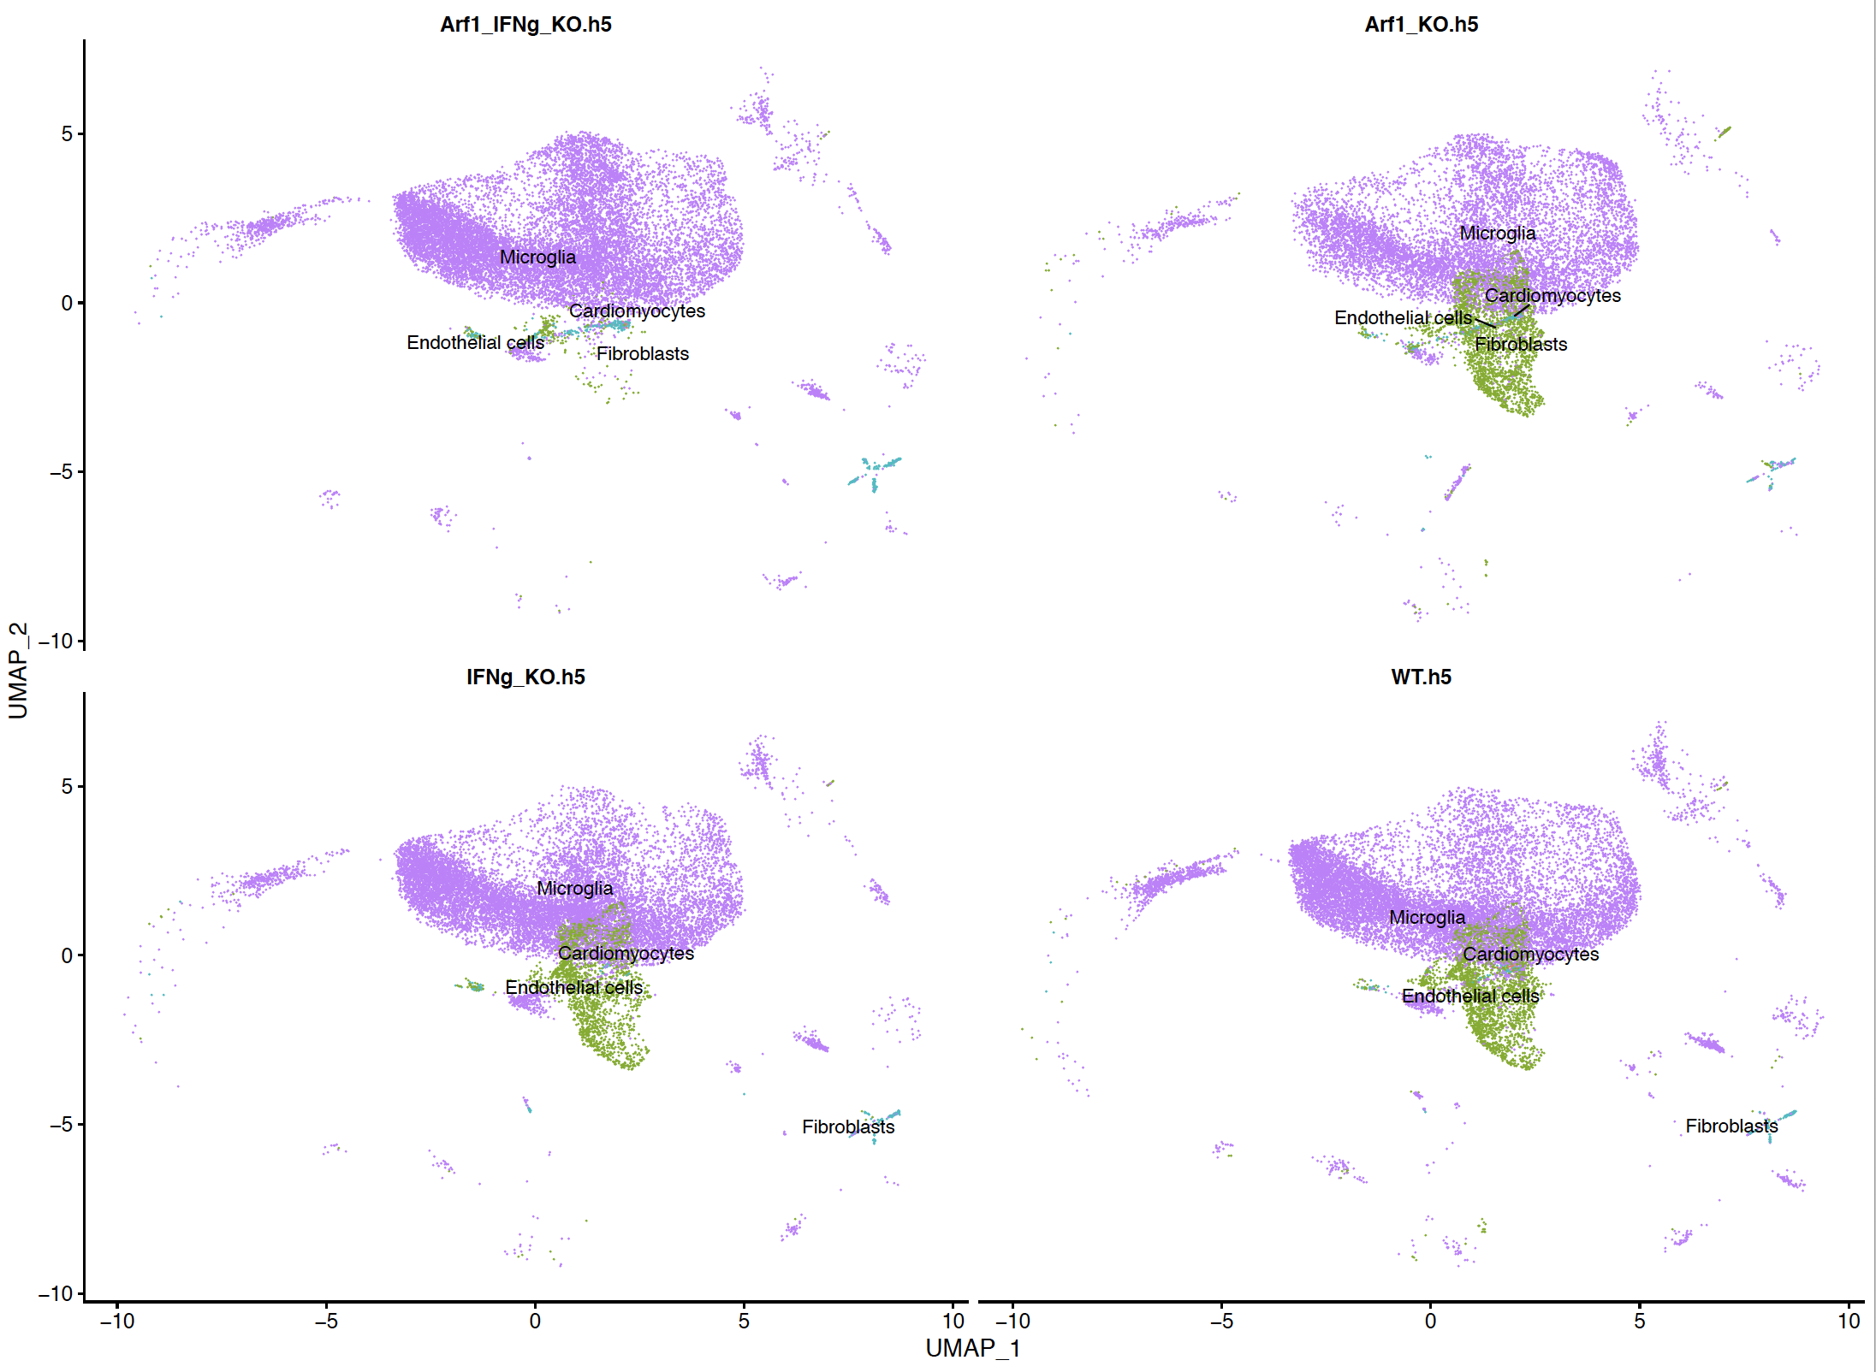
Plotting individual cells to see their position
Before batch-correction
Erythrocytes as labelled by mouseRNAseq database, cluster with Microglia
After batch-correction
Endothelial cells as labelled by mouseRNAseq database, cluster with Microglia

Slide 7
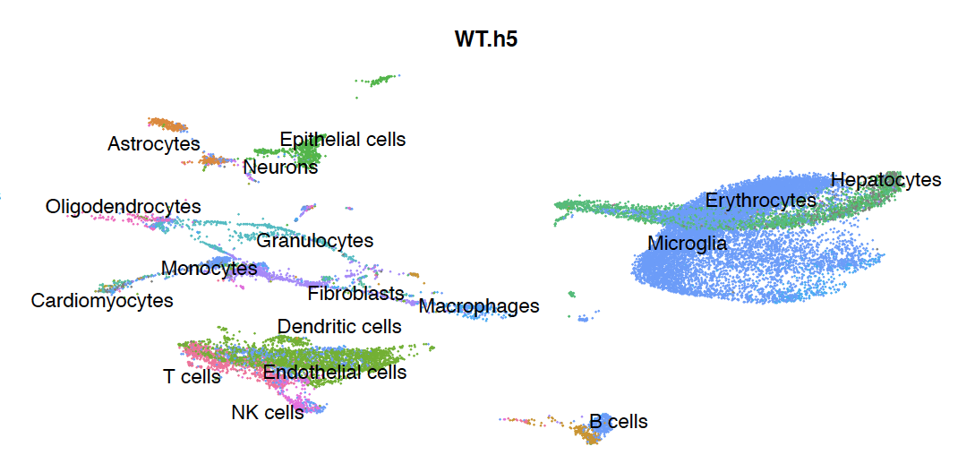
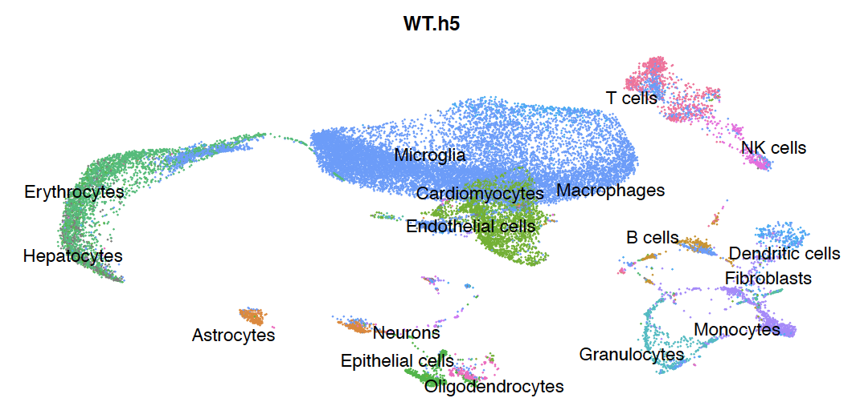
Batch-corrected sample seems to have better cluster separation?
Before batch correction
Batch-corrected
Is before batch correction or after more of how we expect the clusters to separate? Before batch correction, microglia cell clusters are mixed with erythrocytes, which is not expected. Also Endothelial cells and T cells are mixed, which is not expected either. After batch correction, there seems to be better separation of distinct cells types, for example, erythrocytes, microglia, and T cells are well separated. Although the endothelial cells got mixed with microglia cluster. The other concern I have with batch corrected is the microglia cluster becomes very homogenized (see Page3, overlaid samples), it is possible some biologically interesting variation may be removed too.

Slide 8
There isn’t too much changing before and after batch correction regarding the samples themselves. So we might go with before batch-correction. Just a few more checks…

Slide 9
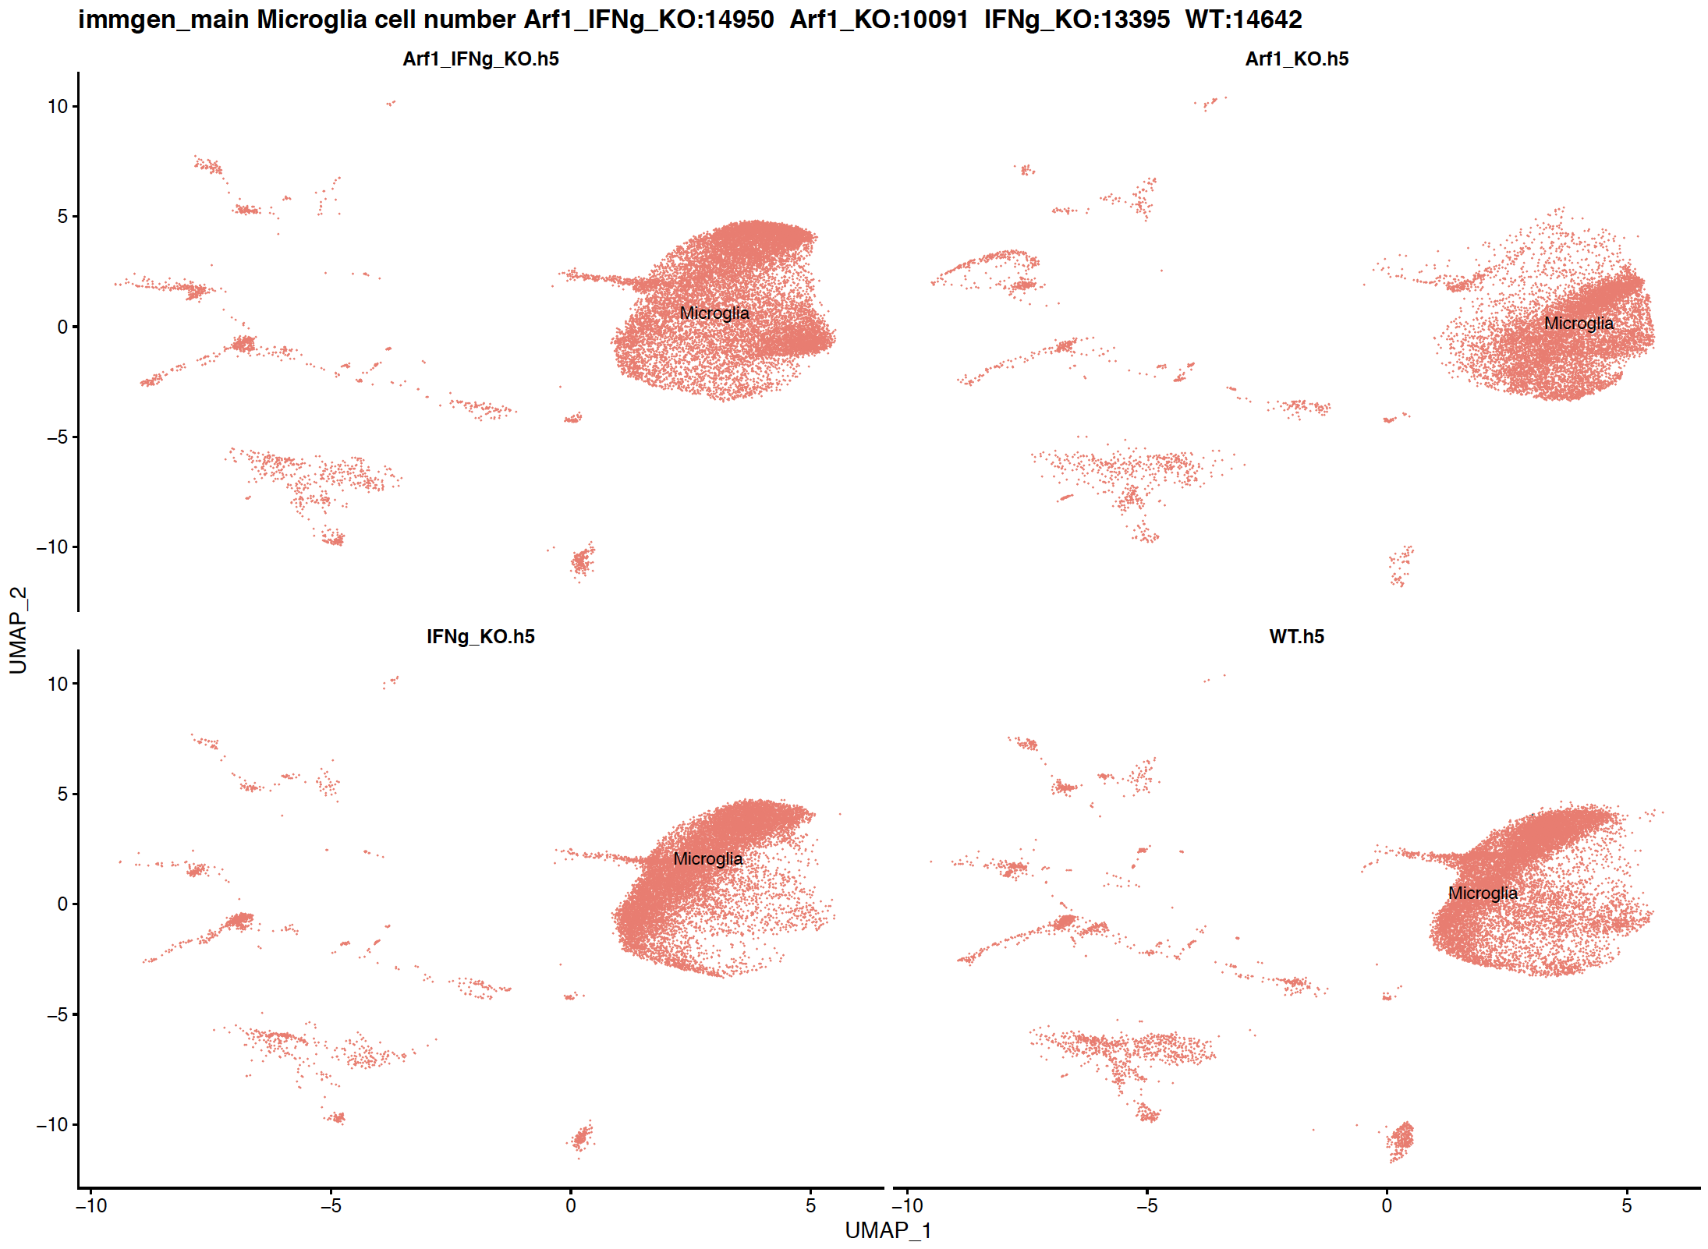
Checking to see the number of microglial cells
The number of cells labeled as microglia by immgen and mouseRNAseq.
Since the study focus is microglia, we should expect good concordance between the two.
Immgen has ~10% more cells labelled as microglia.

Slide 10
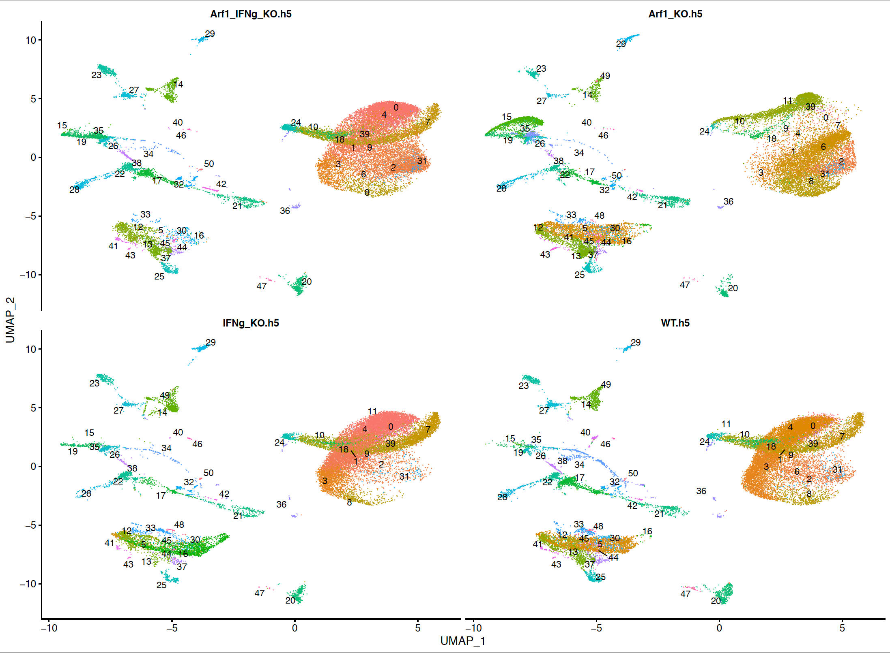
Seurat clusters res1.2 split by sample
seurat_clusters | mouseRNAseq_main
0 | Microglia
1 | Microglia
2 | Microglia
3 | Microglia
4 | Microglia
5 | NA
6 | Microglia
7 | NA
8 | Microglia
9 | Erythrocytes
10 | Erythrocytes
11 | Erythrocytes
12 | T cells
13 | NK cells
14 | Epithelial cells
15 | Oligodendrocytes
16 | Microglia
17 | Monocytes
18 | Microglia
19 | Oligodendrocytes
20 | Microglia
21 | Macrophages
22 | Microglia
23 | Astrocytes
24 | Erythrocytes
25 | NK cells
seurat_clusters | mouseRNAseq_main
26 | Granulocytes
27 | Neurons
28 | Monocytes
29 | Epithelial cells
30 | Microglia
31 | Microglia
32 | Fibroblasts
33 | Endothelial cells
34 | Granulocytes
35 | Neurons
36 | Microglia
37 | Endothelial cells
38 | Monocytes
39 | Epithelial cells
40 | Microglia
41 | T cells
42 | Fibroblasts
43 | Microglia
44 | T cells
45 | Endothelial cells
46 | Fibroblasts
47 | T cells
48 | Endothelial cells
49 | Epithelial cells
50 | Monocytes

Slide 11
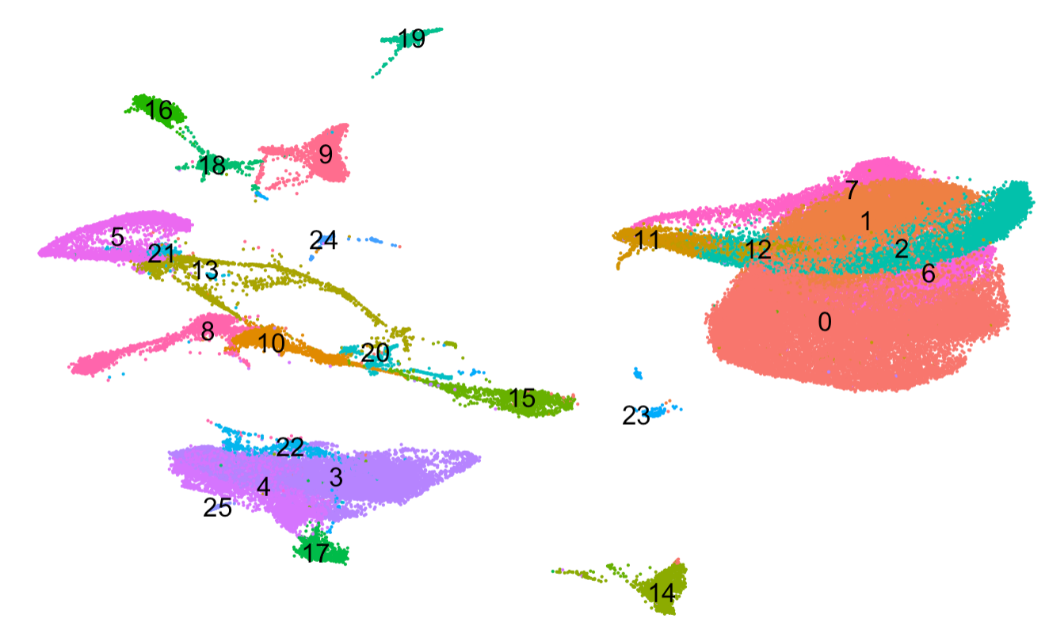
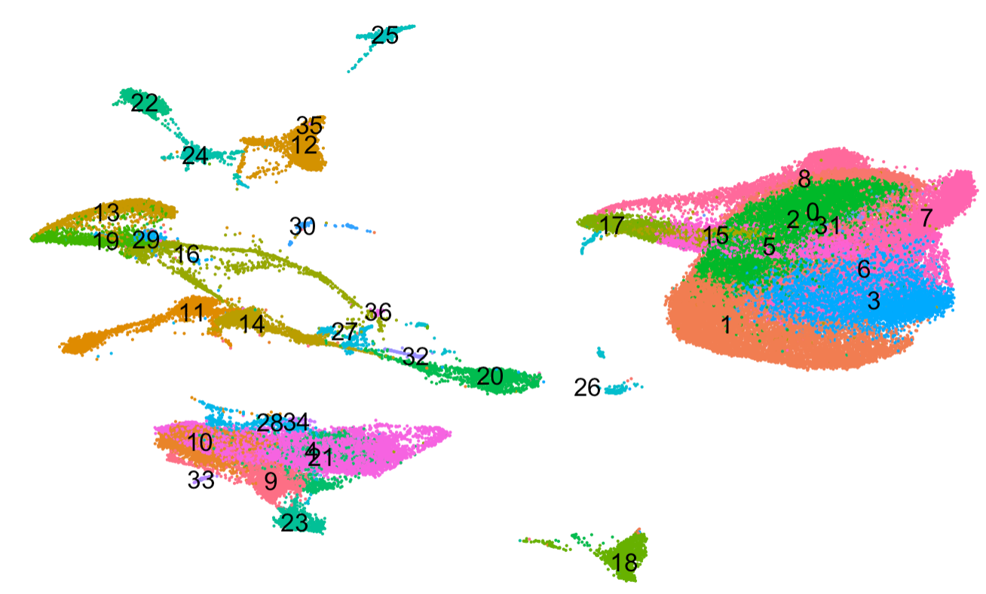
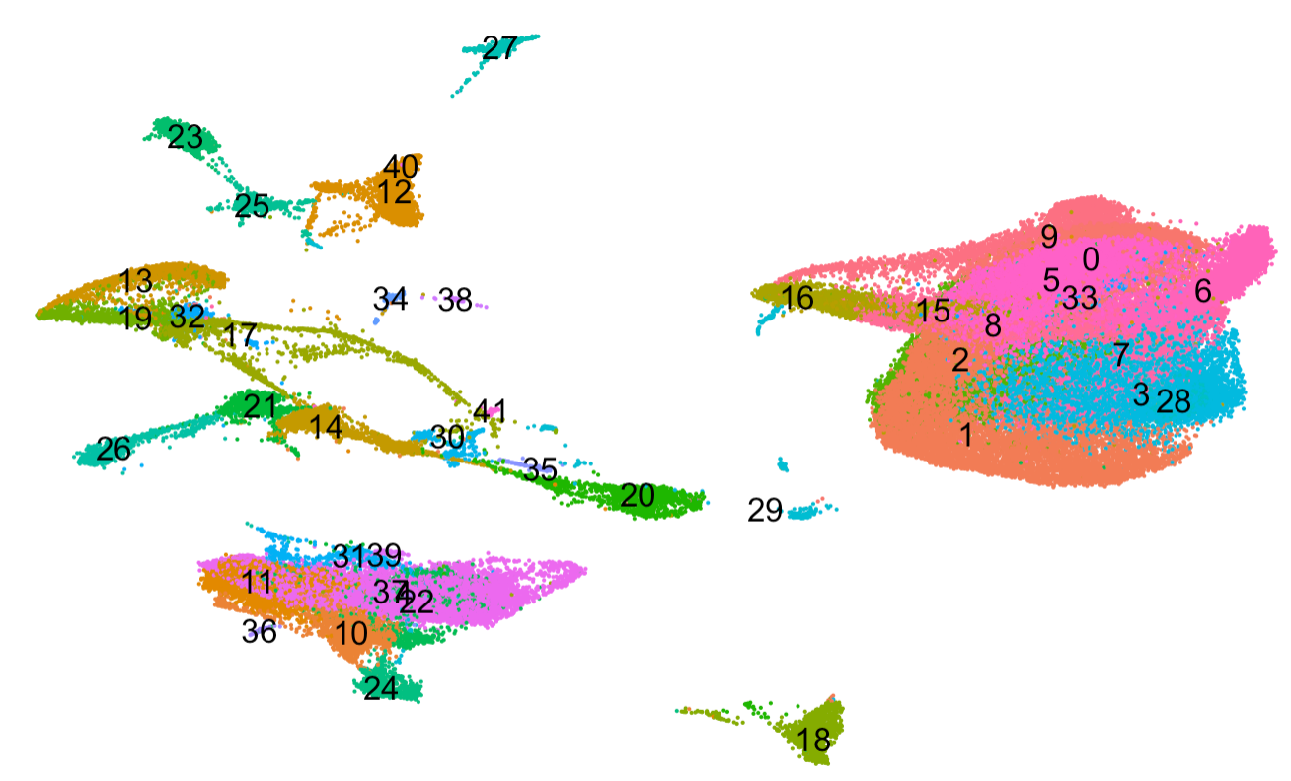
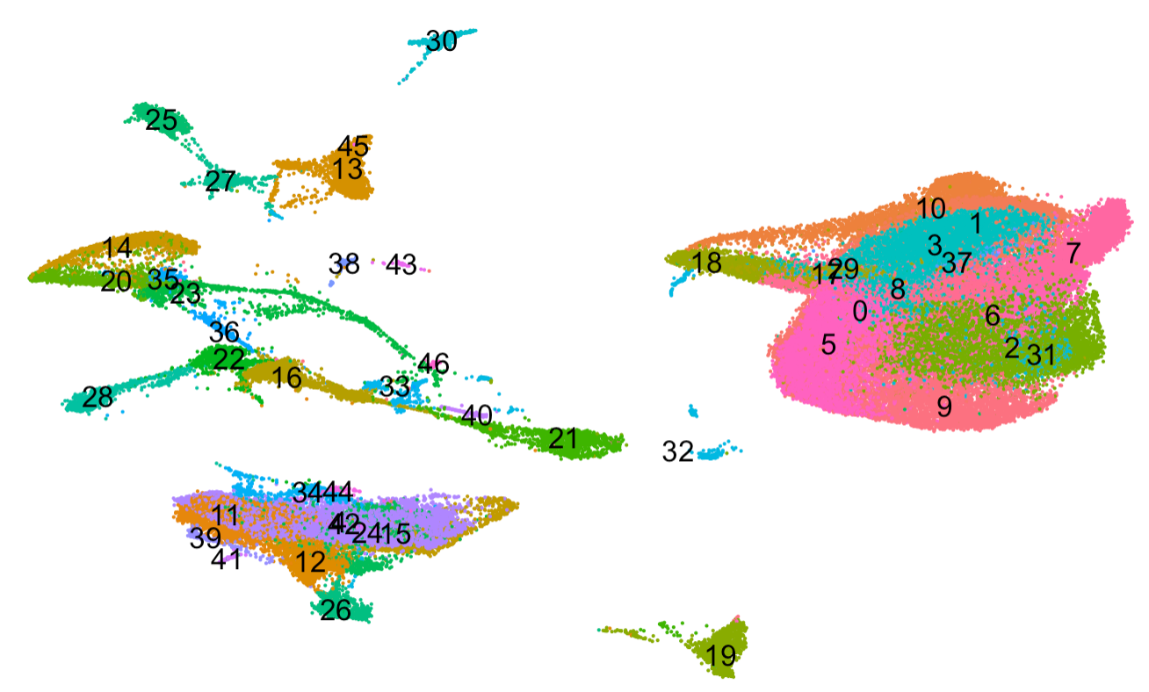
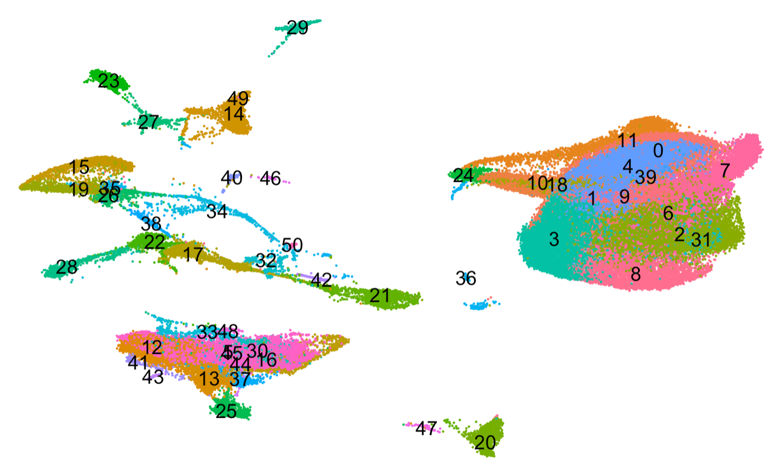
Resolution 0.3
Resolution 0.6
Resolution 0.8
Resolution 1
Resolution 1.2

Slide 12
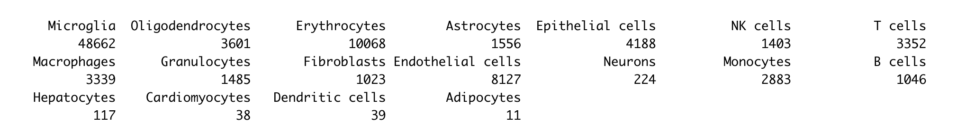
Cell population numbers annotated by mouseRNAseq_main

Slide 13
DE objectives
Confirm which clusters are microglia, features=c("Cx3cr1", "Tmem119", "Aif1", "P2ry12","Cd68","Cd45").
Confirm which clusters that mix with microglia aren’t microglia
DEG analysis questions:
Within combined sample, microglia clusters: (to find markers for each cluster)
Compare cluster 0 to other clusters; cluster 1 to other clusters;
Between sample, microglia clusters: (to find markers for the Arf1 sample)
- Compare each knock-down sample to WT (treating WT as control)
Arf1-WT(cluster0), Arf1_IFNg-WT(cluster0), IFNg-WT(cluster0);
Arf1-WT(cluster1), Arf1_IFNg-WT(cluster1), IFNg-WT(cluster1);
Arf1-WT(cluster0, 1, 2, 3, 4, 6, 8), Arf1_IFNg-WT(cluster0, 1, 2, 3, 4, 6, 8), IFNg-WT(cluster0, 1, 2, 3, 4, 6, 8);
Arf1-WT(“Microglia”), Arf1_IFNg-WT(“Microglia”), IFNg-WT (“Microglia”)
- Compare Arf1 sample to each other sample? (treating Arf1 as control)
1. Arf1-WT(cluster0), Arf1-Arf1_IFNg (cluster0), Arf1-IFNg(cluster0);

Slide 14
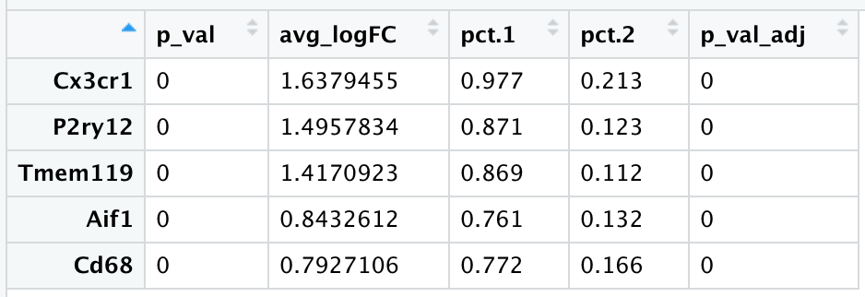
Compare all the microglia clusters (annotated by mouseRNAseq_main) to other clusters and test for differential expression of the microglia marker genes.

Slide 16
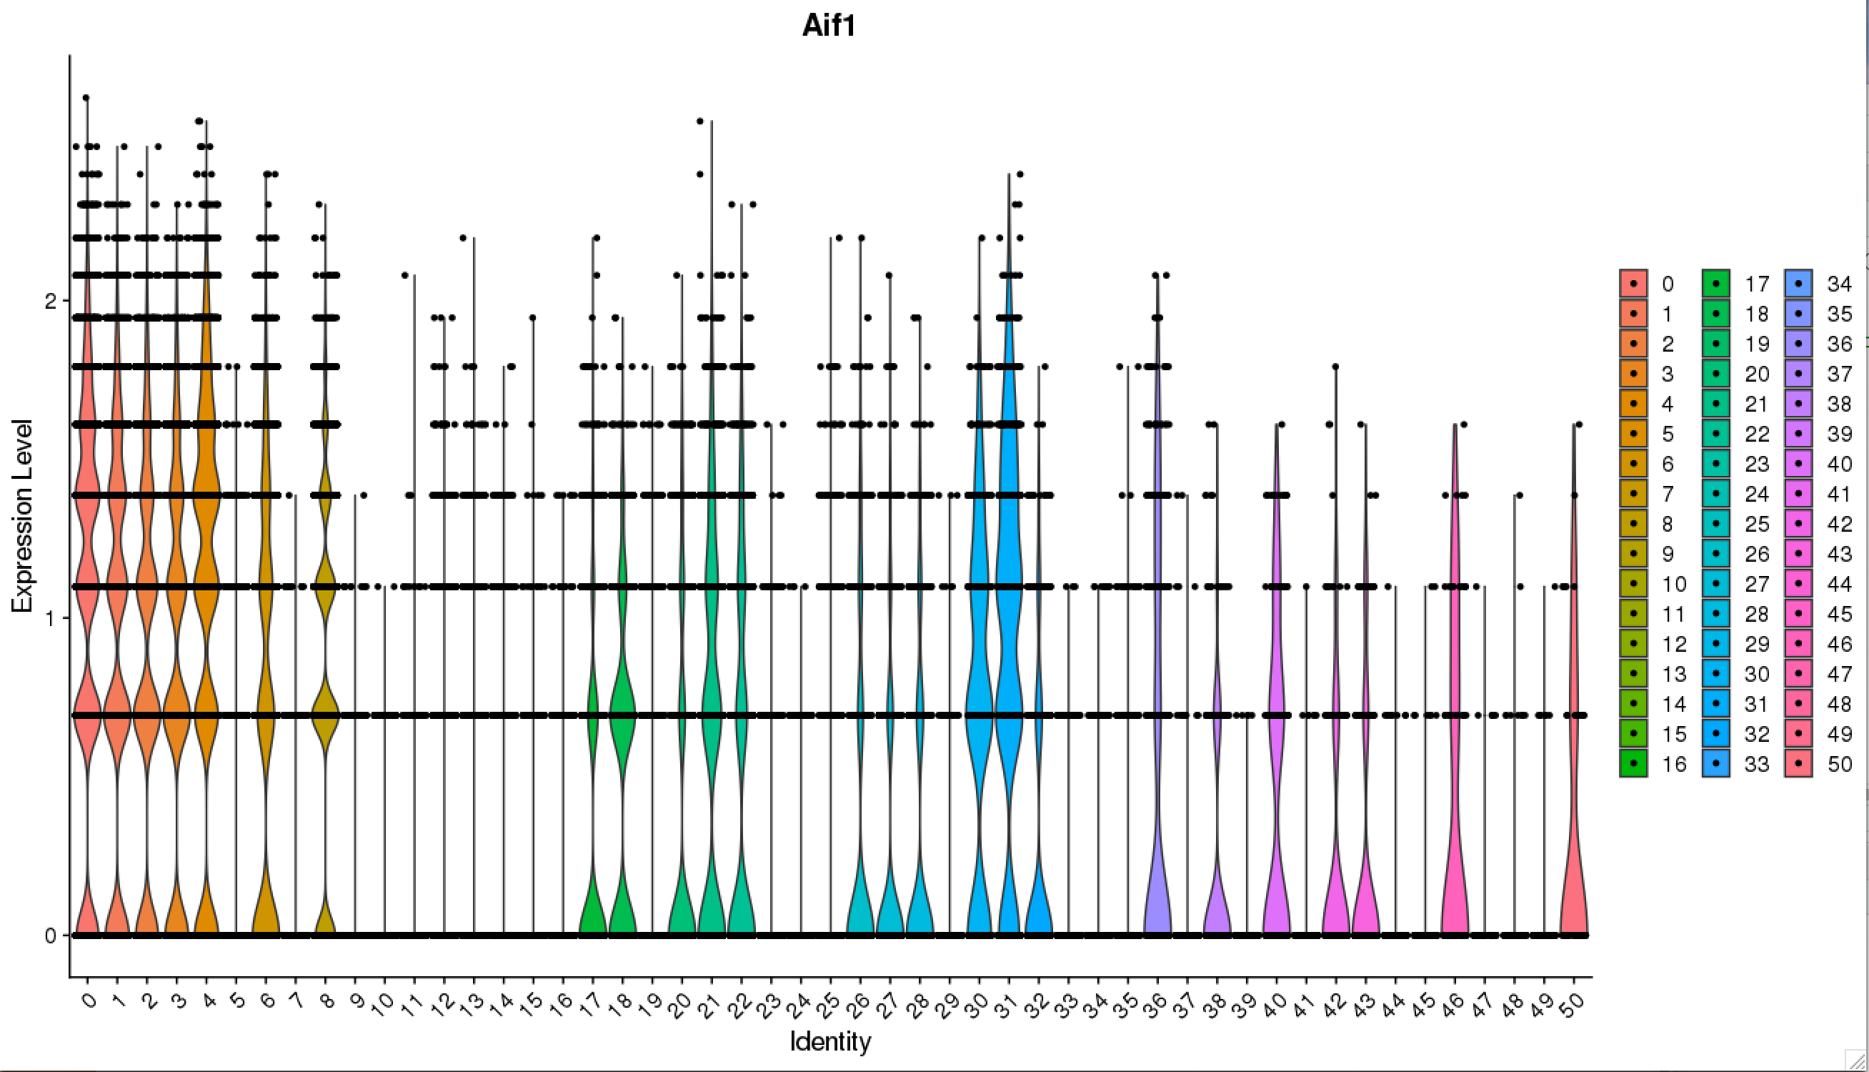

Slide 17
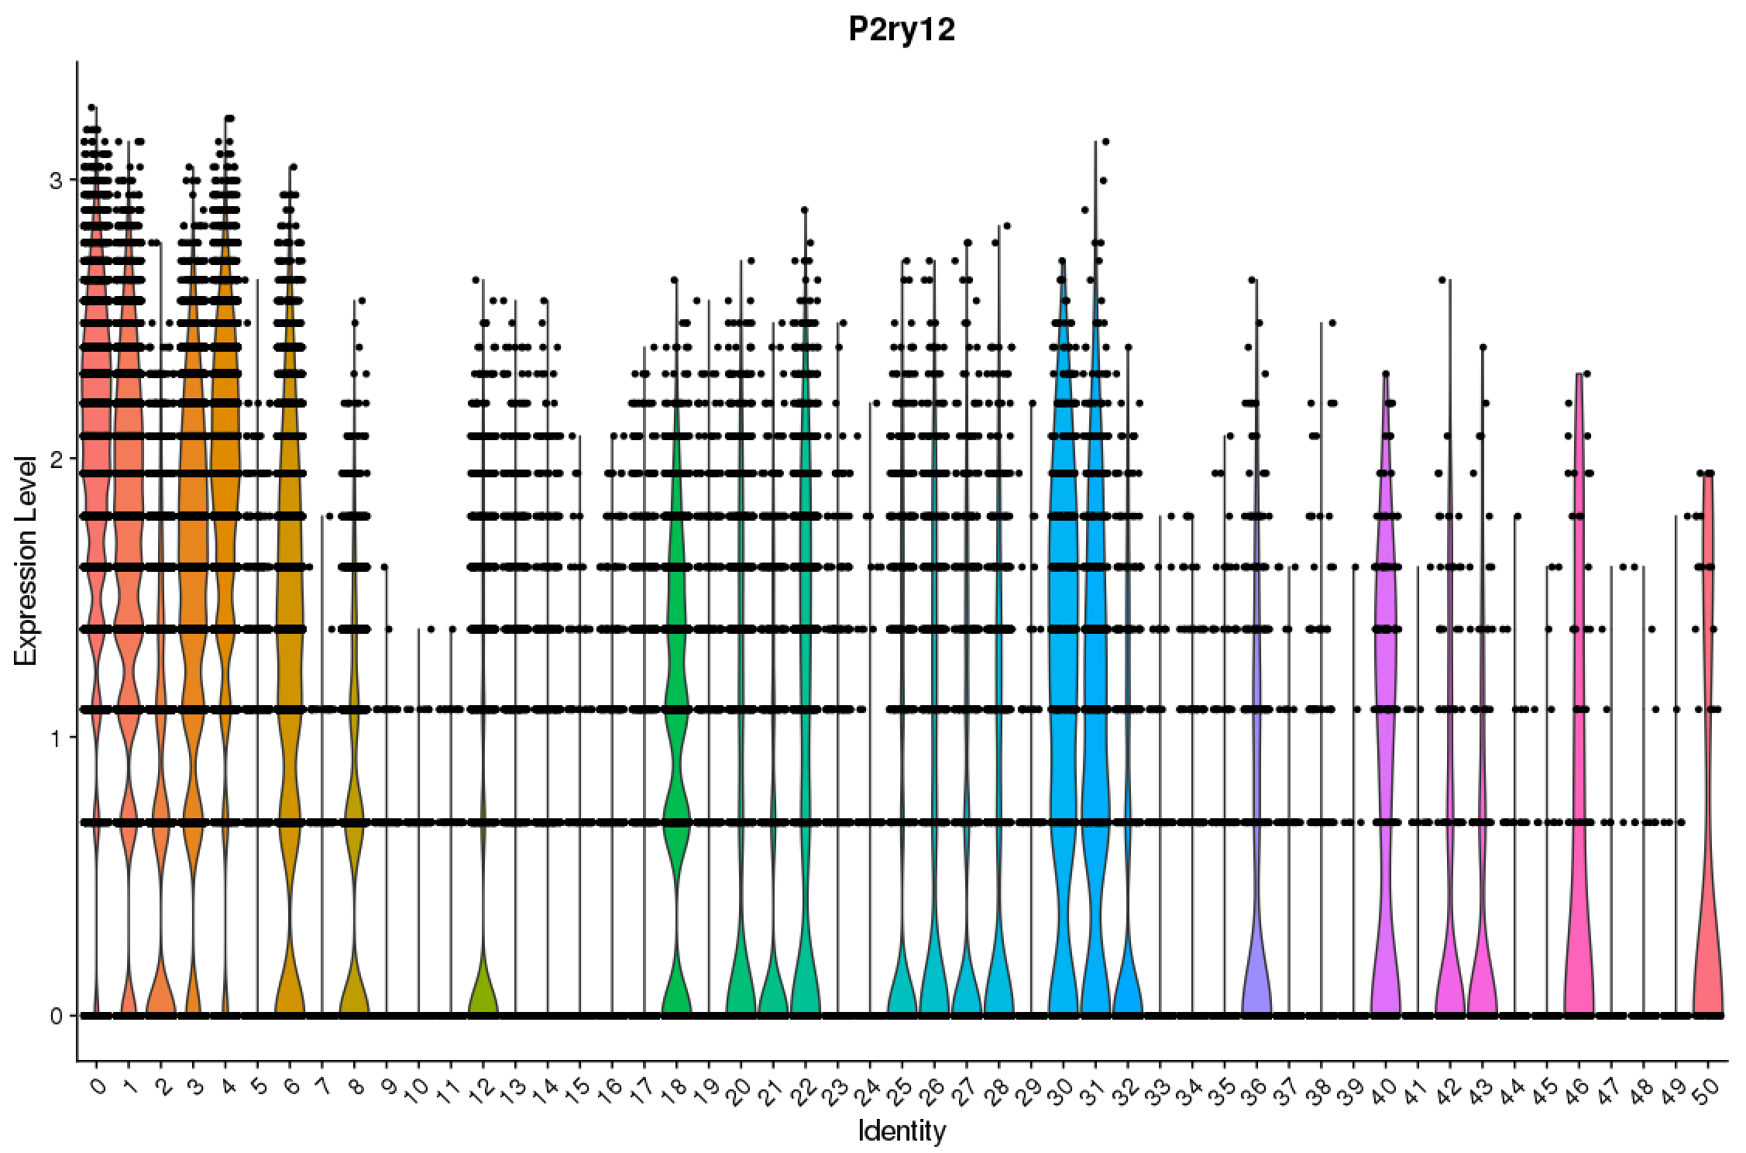

Slide 18
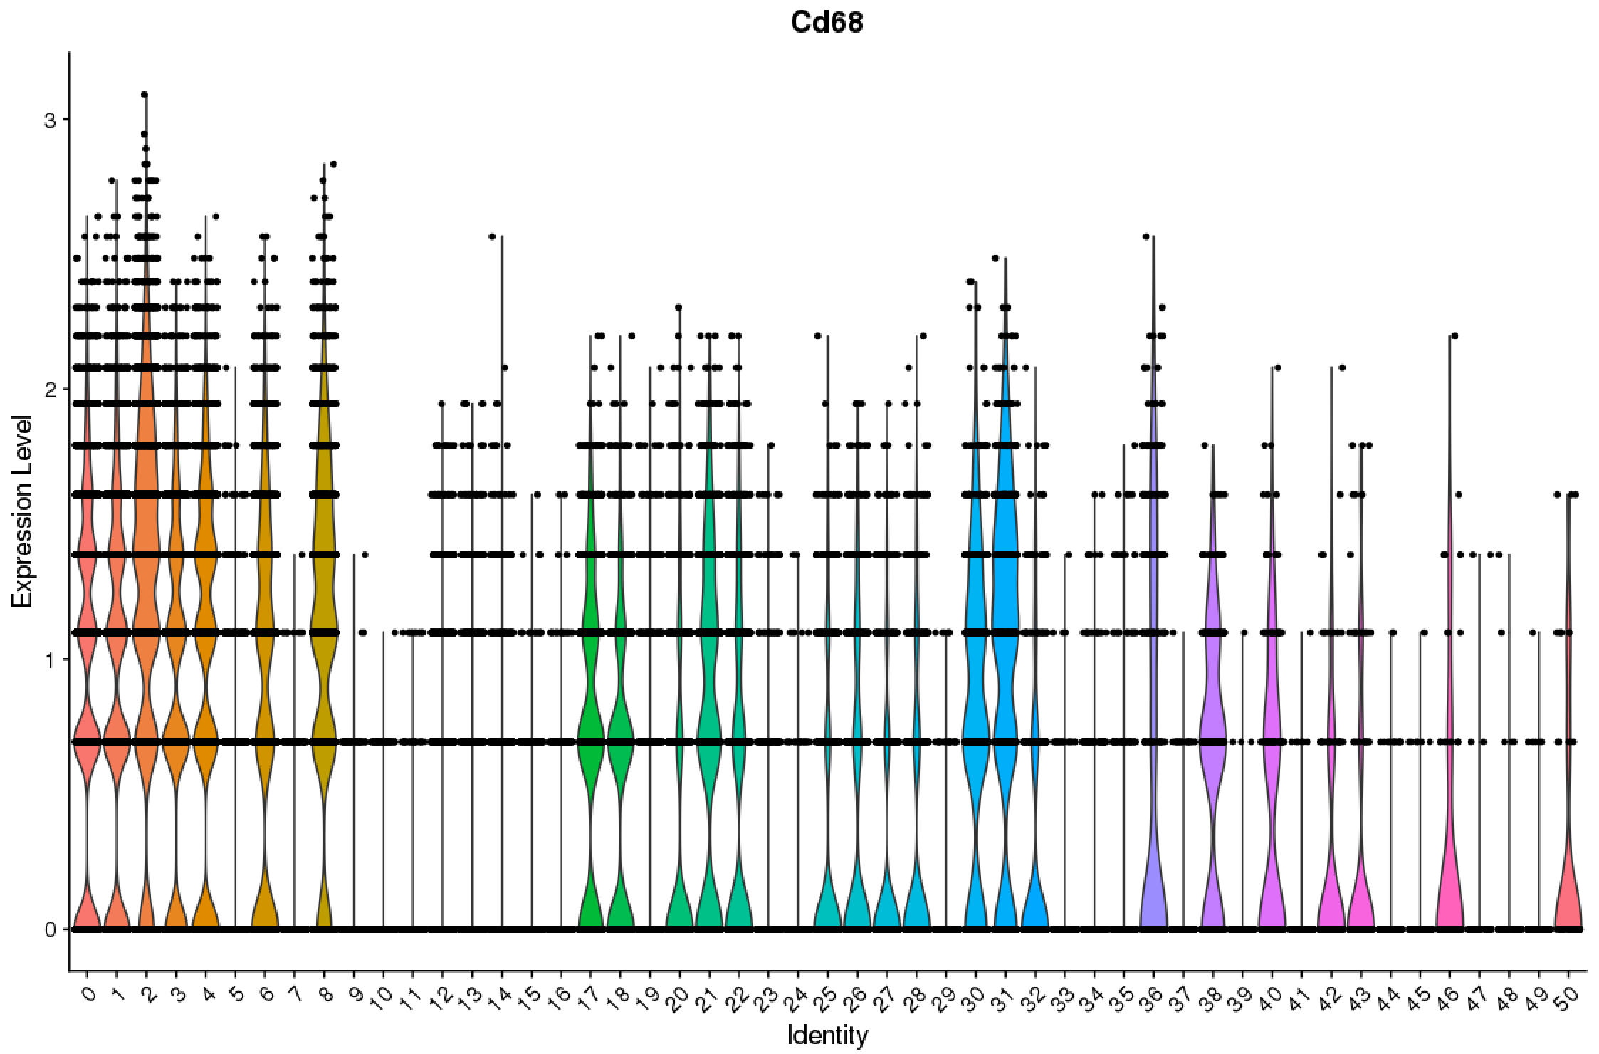

Slide 19
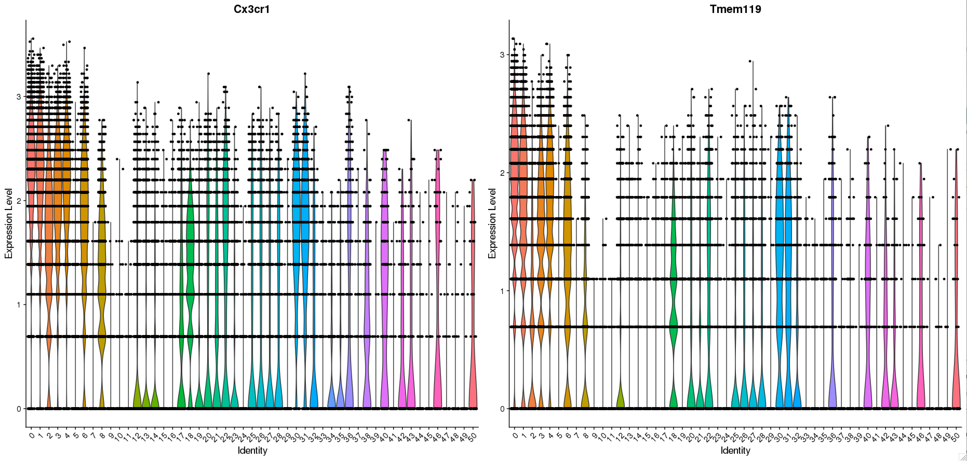

Slide 20
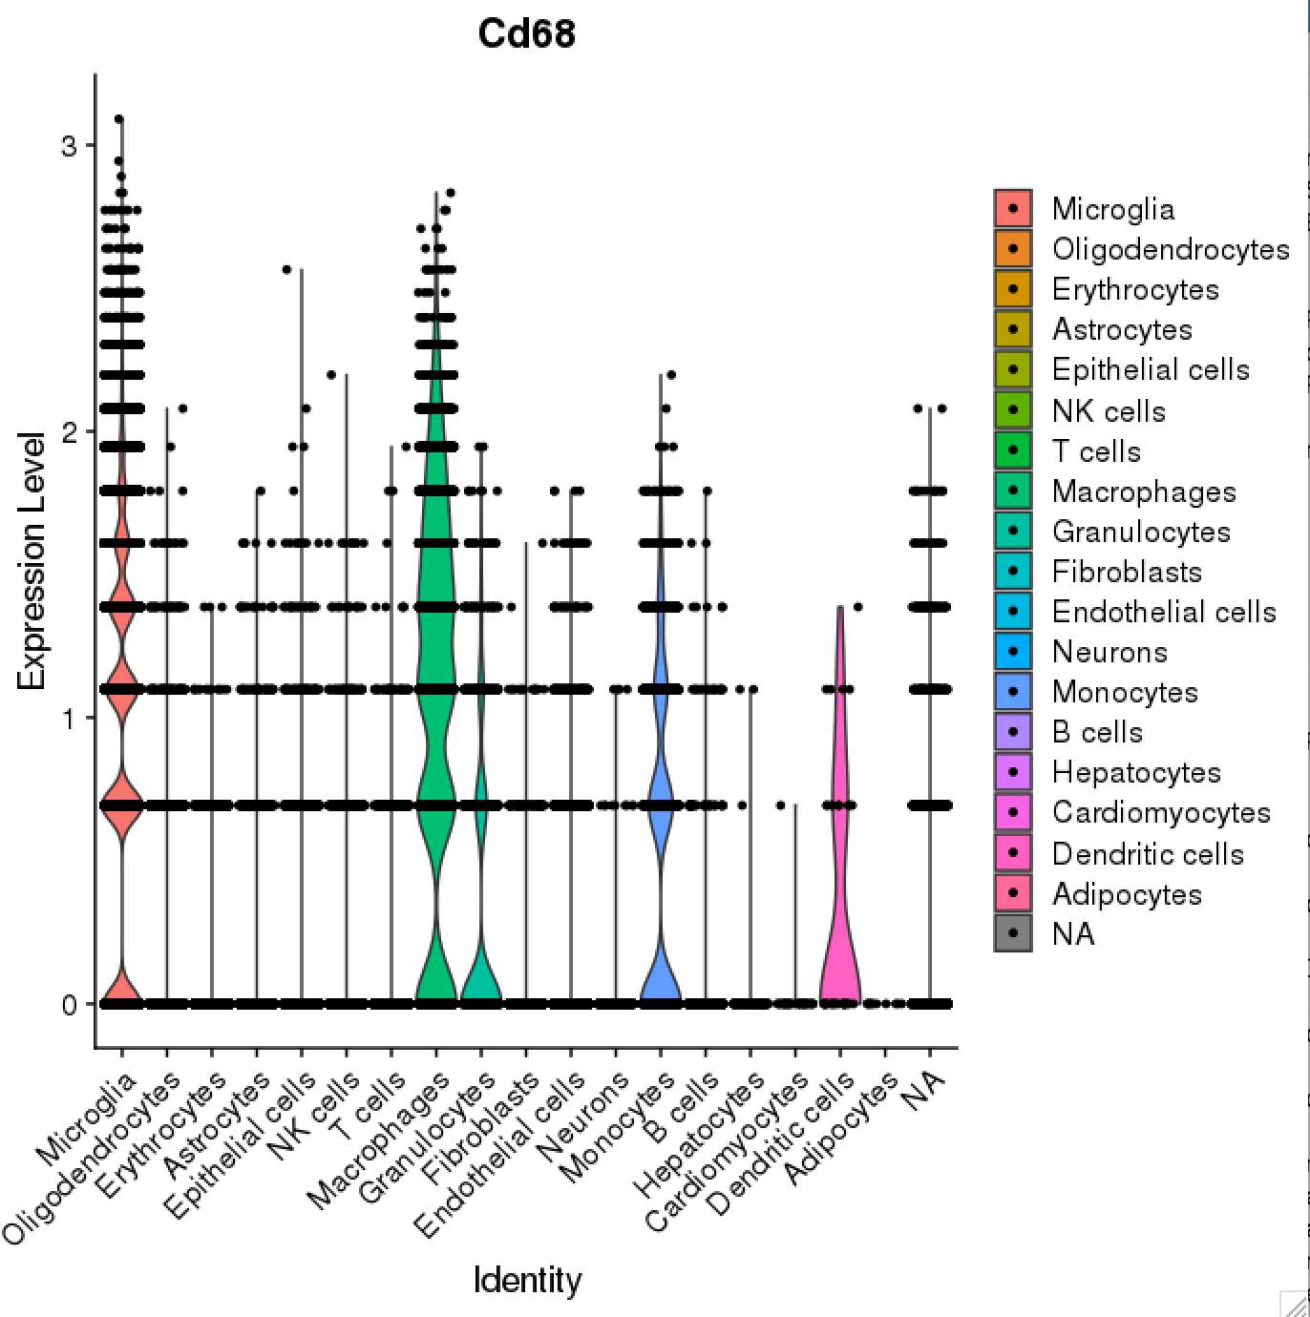

Slide 21
mouseRNAseq_main microglia differential expression – DEGs common to all three contrasts

Slide 22
mouseRNAseq_main microglia differential expression – DEGs common to all three contrasts
 | Arf1 - Arf1.IFNg | Arf1 - IFNg | Arf1 - WT
Gh | 2.2601131 | 2.2580543 | 2.2539953
Prl | 1.3881627 | 1.3878029 | 1.3561963
Ttr | 0.7251019 | 0.6756903 | 0.9272252
Apod | 0.6499153 | 0.5500515 | 0.5531819
Pomc | 0.3739642 | 0.5384407 | 0.3896798
Rbm3 | 0.3182811 | 0.3837139 | 0.3750010
Hbb-bs | -0.2970969 | 0.3742991 | -0.2946736
Cx3cr1 | -0.3108693 | -0.4587319 | -0.3059742
Gpr34 | -0.3946505 | -0.4685851 | -0.4441504
Sparc | -0.4760408 | -0.5313699 | -0.4724615
Cst3 | -0.8293340 | -0.5352697 | -0.5062032
Gm26825 | -0.9311943 | -0.5626591 | -0.2716750
P2ry12 | -0.4047551 | -0.6170945 | 0.2814050
Marcks | -0.2700342 | -1.0073088 | -0.3187753
Ccl3 | 0.5233011 | -1.2355064 | -0.2997791
Siglech | -0.2935748 | -0.3230028 | -0.2975228
Tmem119 | -0.3321814 | -0.2763223 | 0.3123555
Lgals3bp | 0.3070131 | 0.2587596 | 0.2651458
H2-D1 | 0.2856554 | -0.3015456 | -0.2621052
Ier3 | 0.3555399 | 0.4715129 | -0.2767758
Cxcl2 | 0.3010432 | 0.3712888 | 0.3039998
S100a9 | -0.2961911 | 0.3466460 | 0.2864130
Hspa1a | -0.2897662 | -0.2879384 | 0.2882253
 | Arf1.IFNg - WT | IFNg - WT | Arf1 - WT
Gm26825 | 1.1963401 | 1.5006522 | 0.9223484
Apoe | 0.9011597 | 0.6284356 | 0.4004677
Cst3 | 0.3851837 | 0.5631584 | -0.4441504
Slc2a5 | -0.3746139 | 0.4015651 | -0.5244208
Fcrls | -0.3986105 | 0.3451437 | -0.2577561
mt-Nd1 | 0.2704647 | 0.3036750 | 0.3261354
mt-Nd4 | 0.2668789 | -0.4349556 | 0.3015796
mt-Co3 | 0.2626265 | -1.0109501 | 0.2651458
avg_logFC

Slide 23
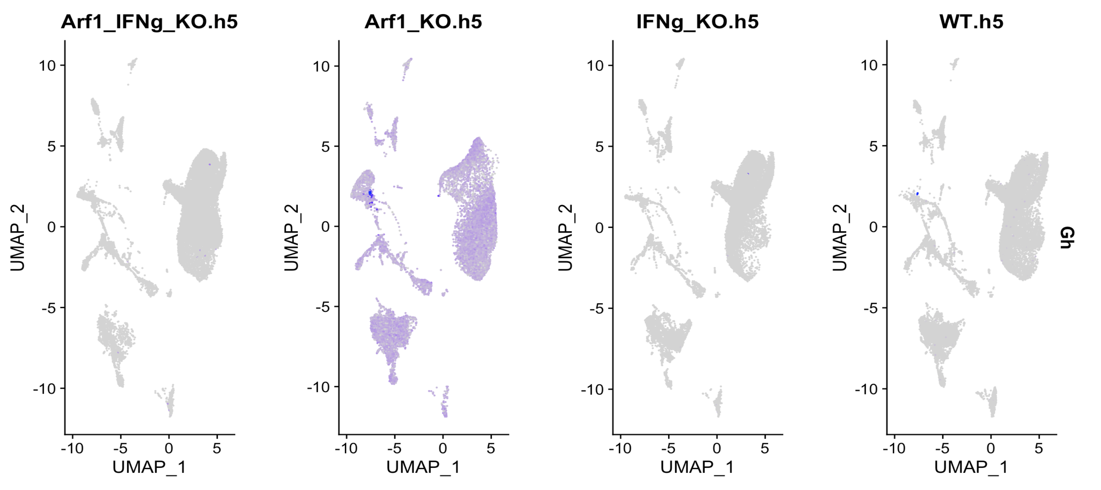
Gh

Slide 24
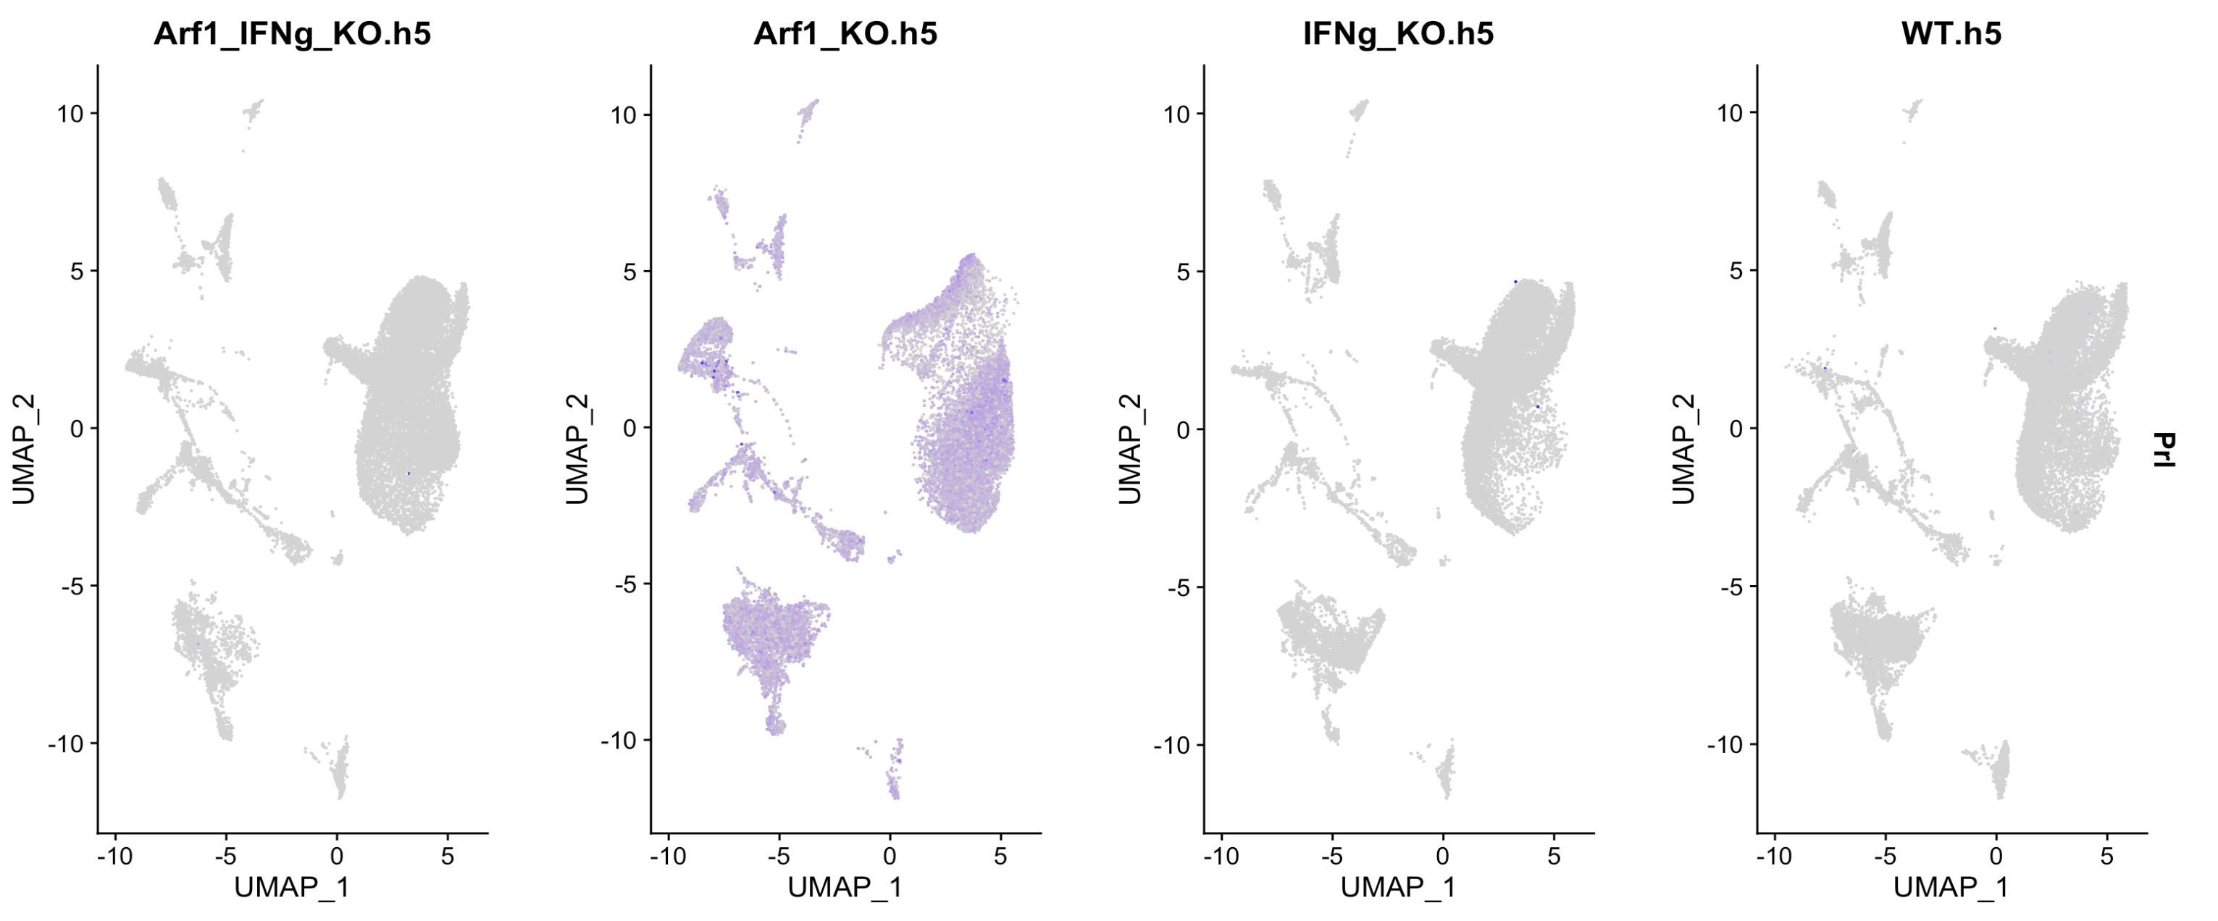
Prl

Slide 25
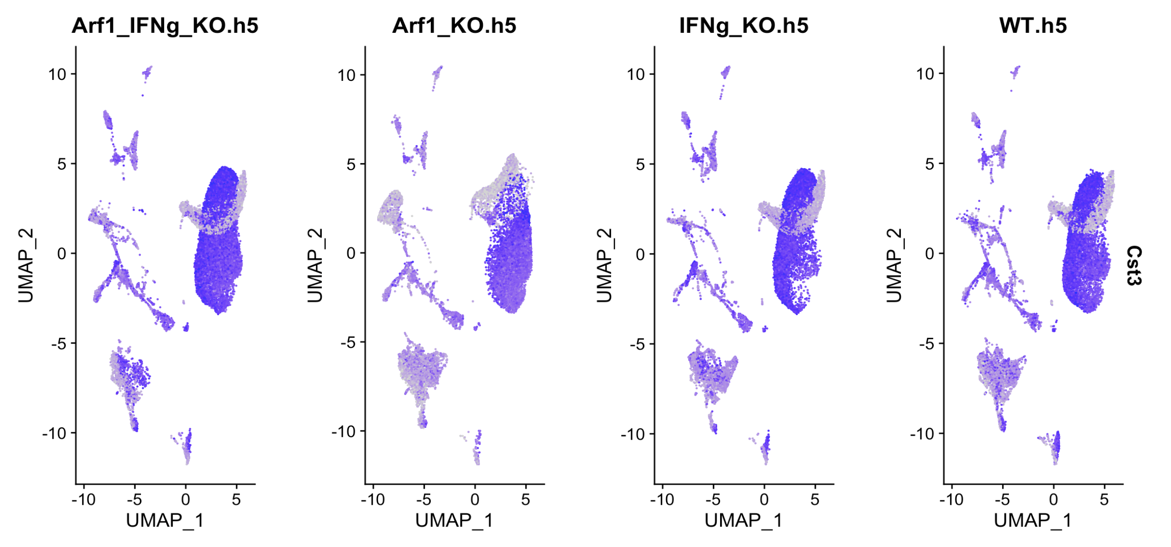
Cst3

Slide 26
mouseRNAseq_main | SCT_snn_res.0.3
Microglia | 0
Microglia | 1
NA | 2
Microglia | 3
NK cells | 4
Oligodendrocytes | 5
Microglia | 6
Erythrocytes | 7
Microglia | 8
Epithelial cells | 9
Monocytes | 10
Erythrocytes | 11
Microglia | 12
Granulocytes | 13
Microglia | 14
Macrophages | 15
Astrocytes | 16
NK cells | 17
Neurons | 18
Epithelial cells | 19
Fibroblasts | 20
Neurons | 21
Endothelial cells | 22
Microglia | 23
Fibroblasts | 24
Microglia | 25
Resolution 0.3

Slide 27
mouseRNAseq_main | SCT_snn_res.0.6
Microglia | 0
Microglia | 1
Microglia | 2
Microglia | 3
NA | 4
Erythrocytes | 5
Microglia | 6
NA | 7
Erythrocytes | 8
NK cells | 9
T cells | 10
Microglia | 11
Epithelial cells | 12
Oligodendrocytes | 13
Monocytes | 14
Microglia | 15
Granulocytes | 16
Erythrocytes | 17
Microglia | 18
Oligodendrocytes | 19
Macrophages | 20
Microglia | 21
Astrocytes | 22
NK cells | 23
Neurons | 24
Epithelial cells | 25
Microglia | 26
Fibroblasts | 27
Endothelial cells | 28
Neurons | 29
Fibroblasts | 30
Epithelial cells | 31
Fibroblasts | 32
Microglia | 33
Endothelial cells | 34
Epithelial cells | 35
Monocytes | 36
Resolution 0.6

Slide 28
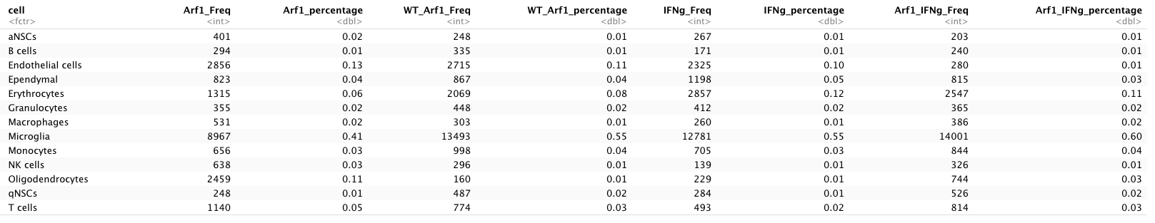
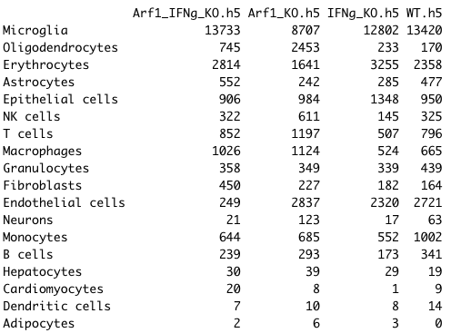
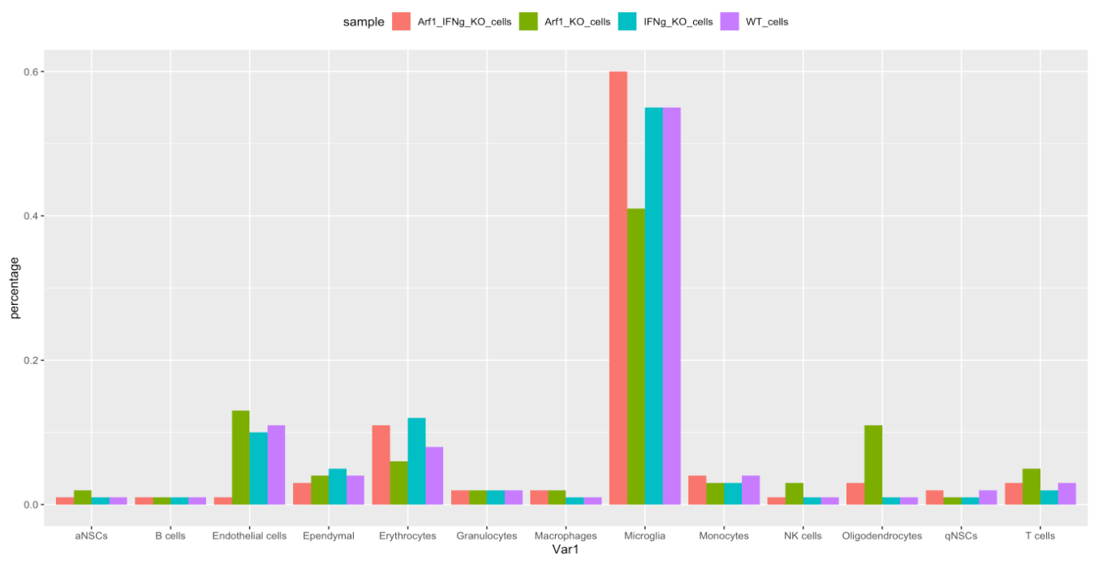
Total cells

Slide 29
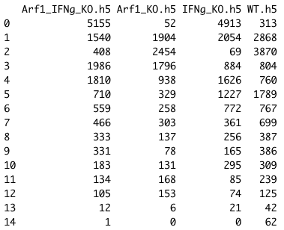
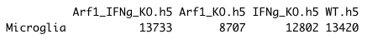
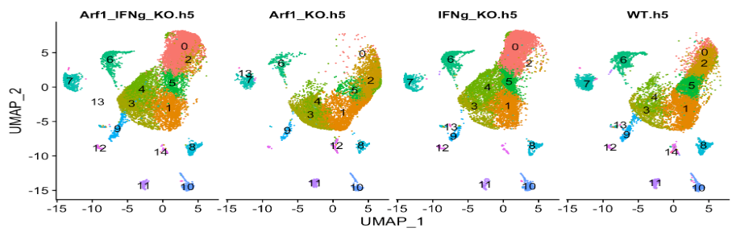
Select only the microglial cells annotated by mouseRNAseq_main, reclusterd the cells
Number of microglia cells in each cluster split by sample

Slide 30
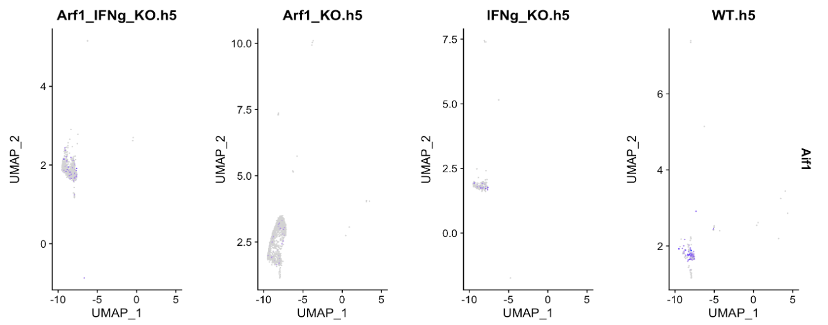
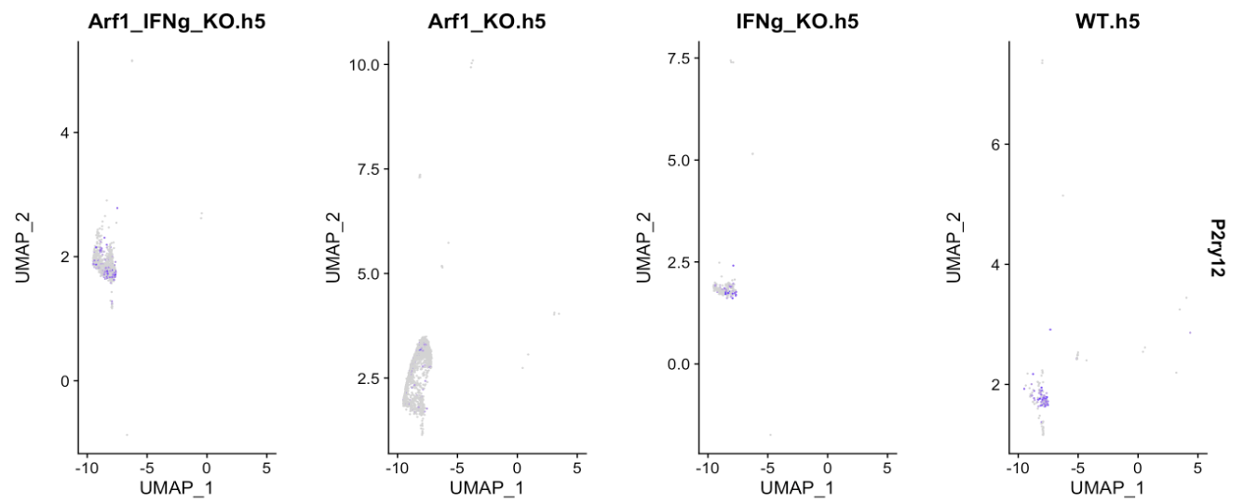
Checking expression of microglia markers in the cells labelled as Oligodendrocytes – weak but nonzero expression

Slide 31
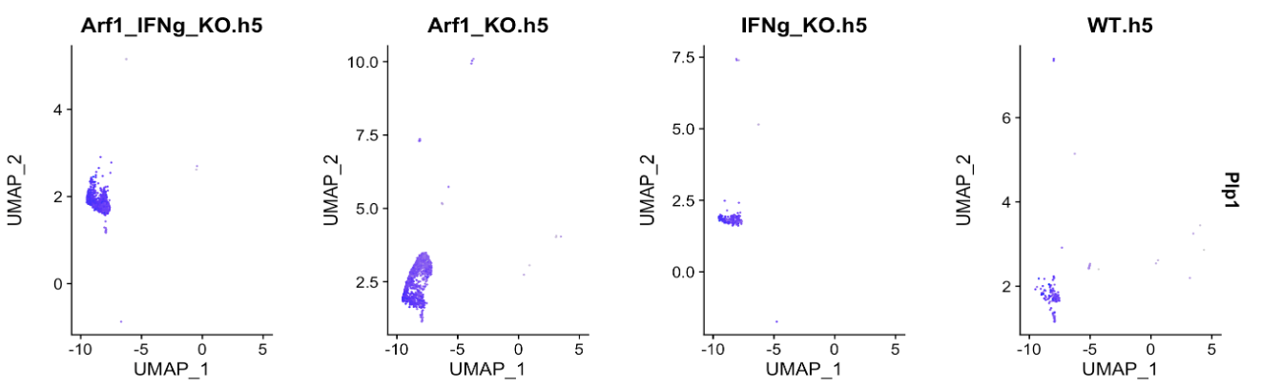
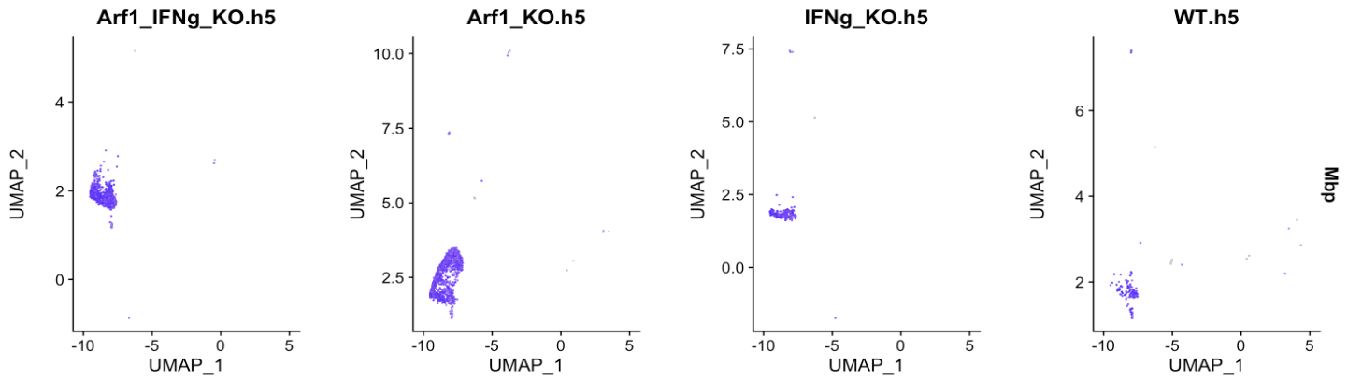
Checking expression of Oligodendrocytes markers
in Oligodendrocytes – high expression as expected

Slide 32
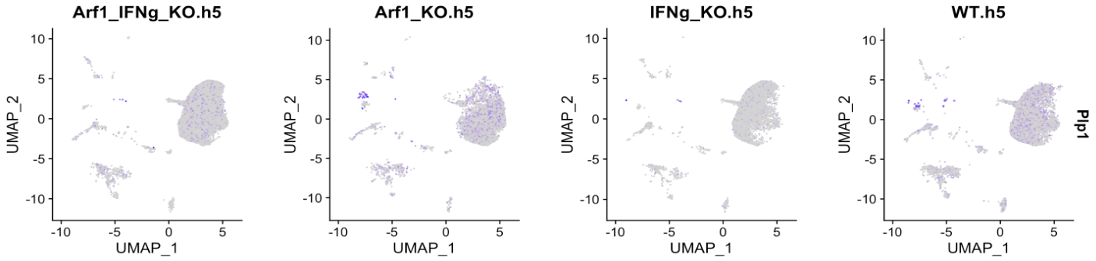
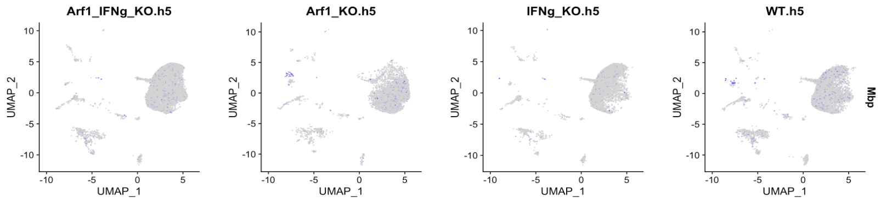
Checking expression of Oligodendrocytes markers
in Microglia – weak but nonzero expression

Slide 33
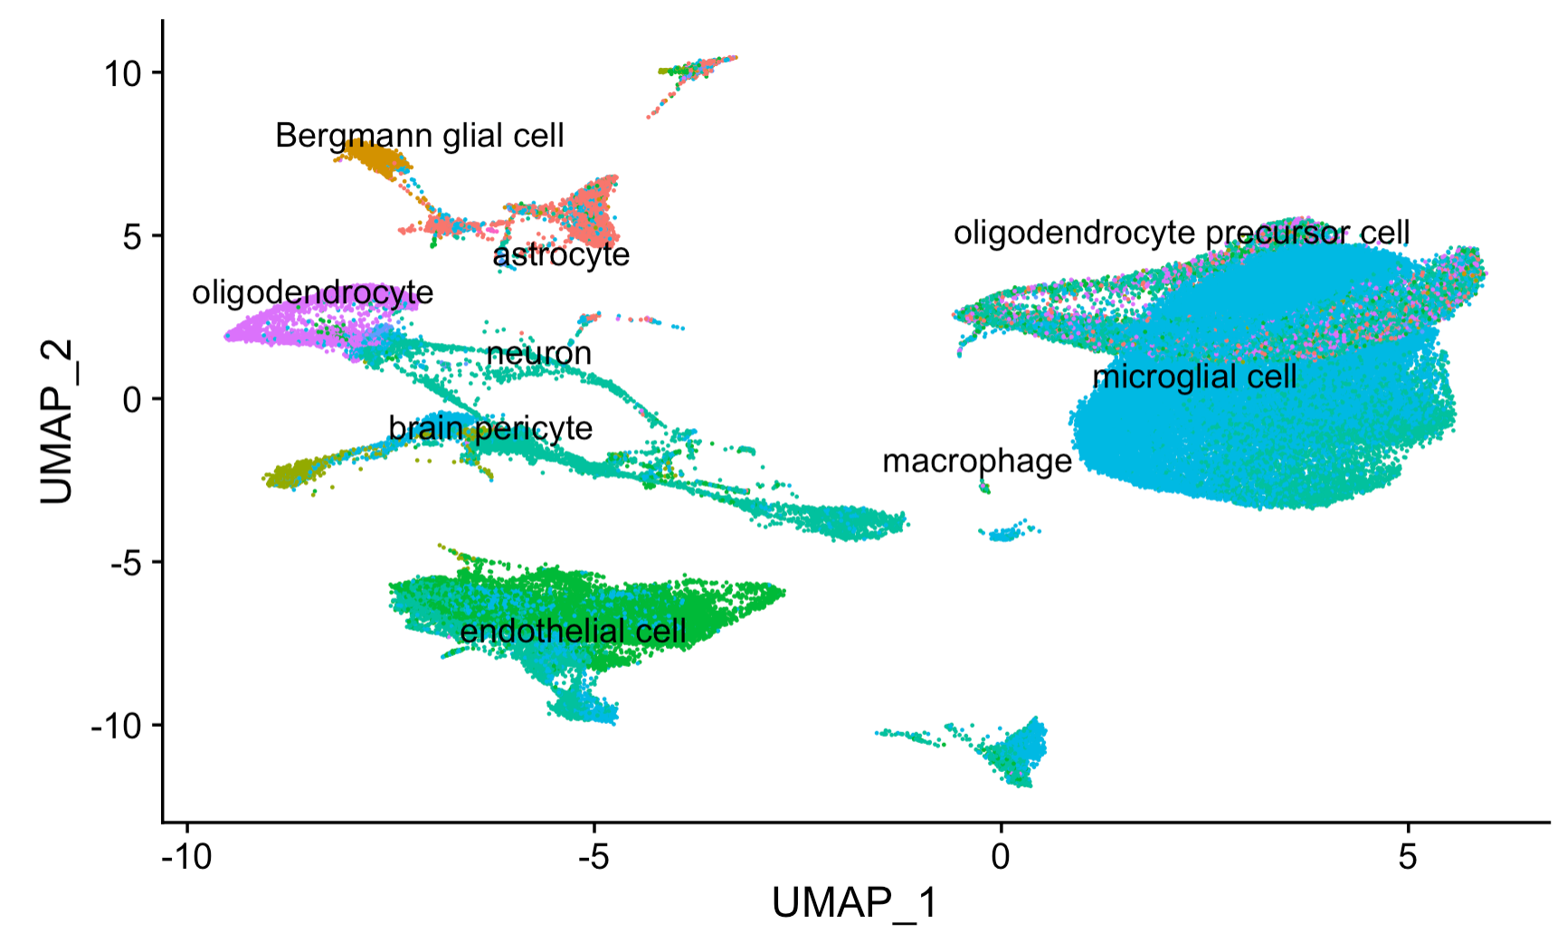
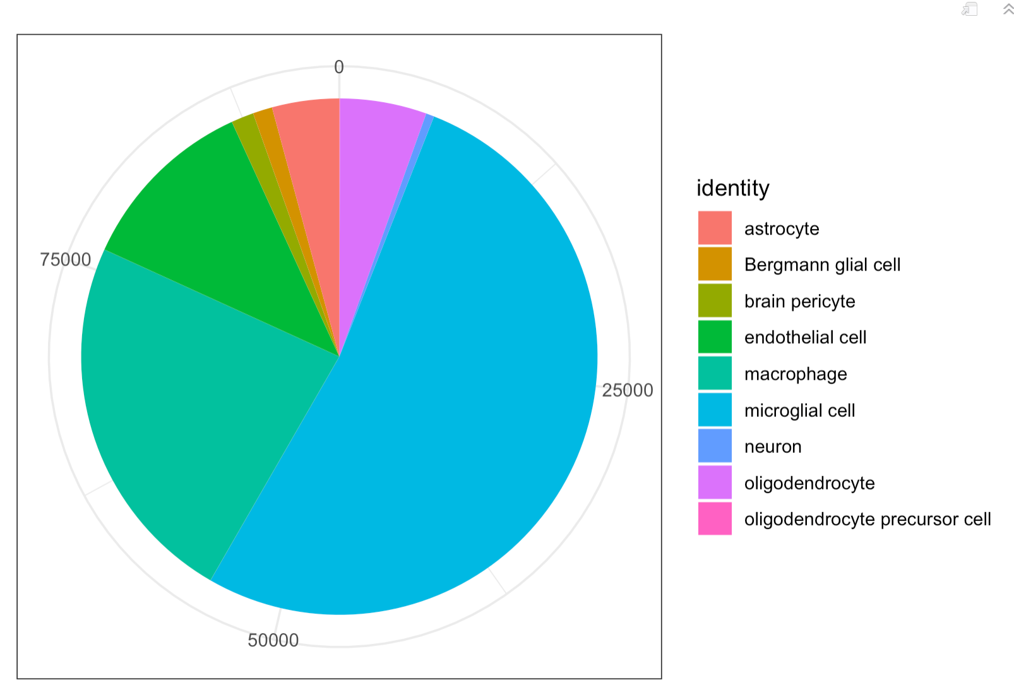
Cell identity annotation by Tabula Muris – over half of the cells are microglia
endothelial
macrophage
microglial cell

Slide 34
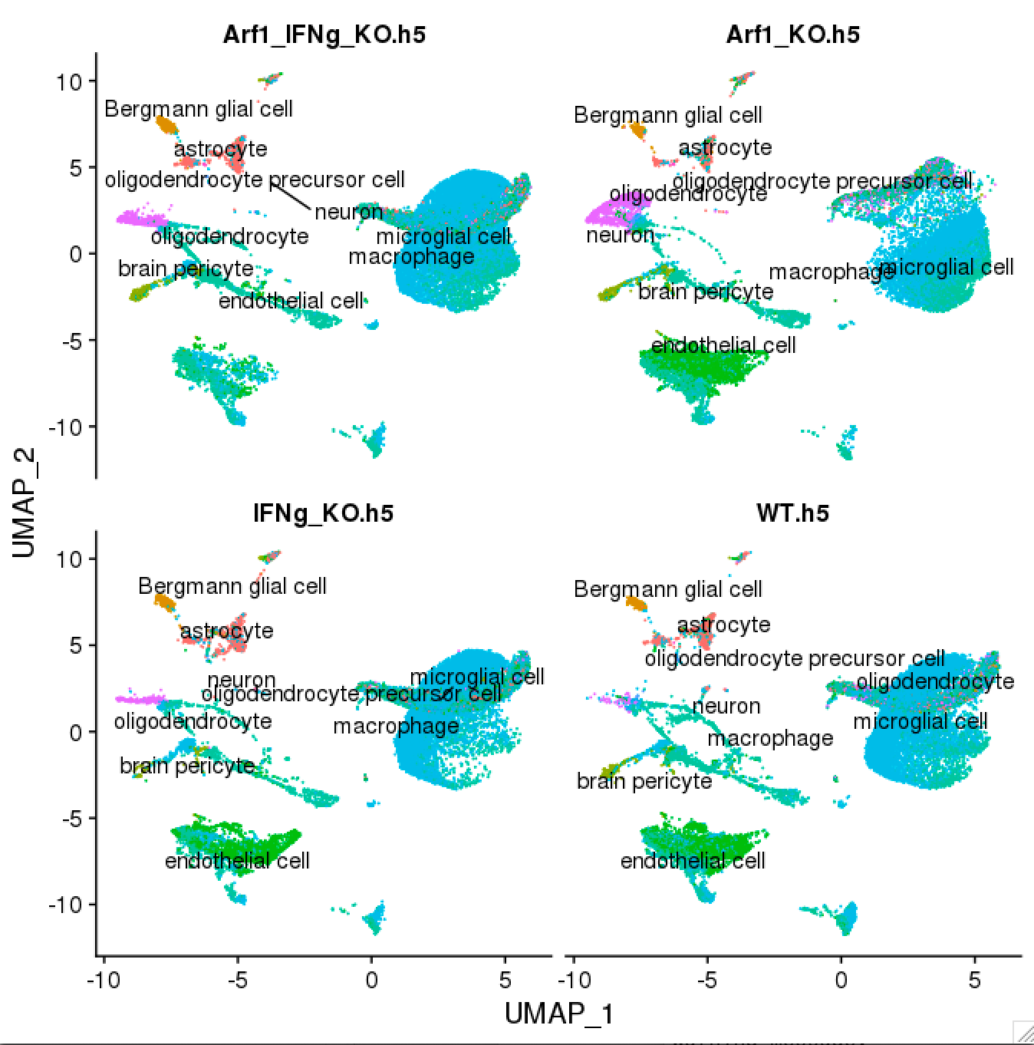
Cell identity and count by sample
cell identity | Arf1_IFNg_KO.h5 | Arf1_KO.h5 | IFNg_KO.h5 | WT.h5
astrocyte | 1136 | 554 | 1177 | 1049
Bergmann glial cell | 380 | 230 | 230 | 297
brain pericyte | 461 | 349 | 241 | 266
endothelial cell | 788 | 3473 | 3053 | 3276
macrophage | 6387 | 6463 | 3853 | 5193
microglial cell | 13238 | 7683 | 14105 | 13763
neuron | 56 | 282 | 58 | 81
oligodendrocyte | 1023 | 2988 | 438 | 602
oligodendrocyte precursor cell | 15 | 14 | 11 | 4
Total | 23484 | 22036 | 23166 | 24531
Notes:
DimPlot(y_x.rds_1.2, reduction= "umap", split.by = 'Sample',label = TRUE,repel=TRUE,na.value=TRUE,group.by="tabulaMuris",ncol=2)

Slide 35
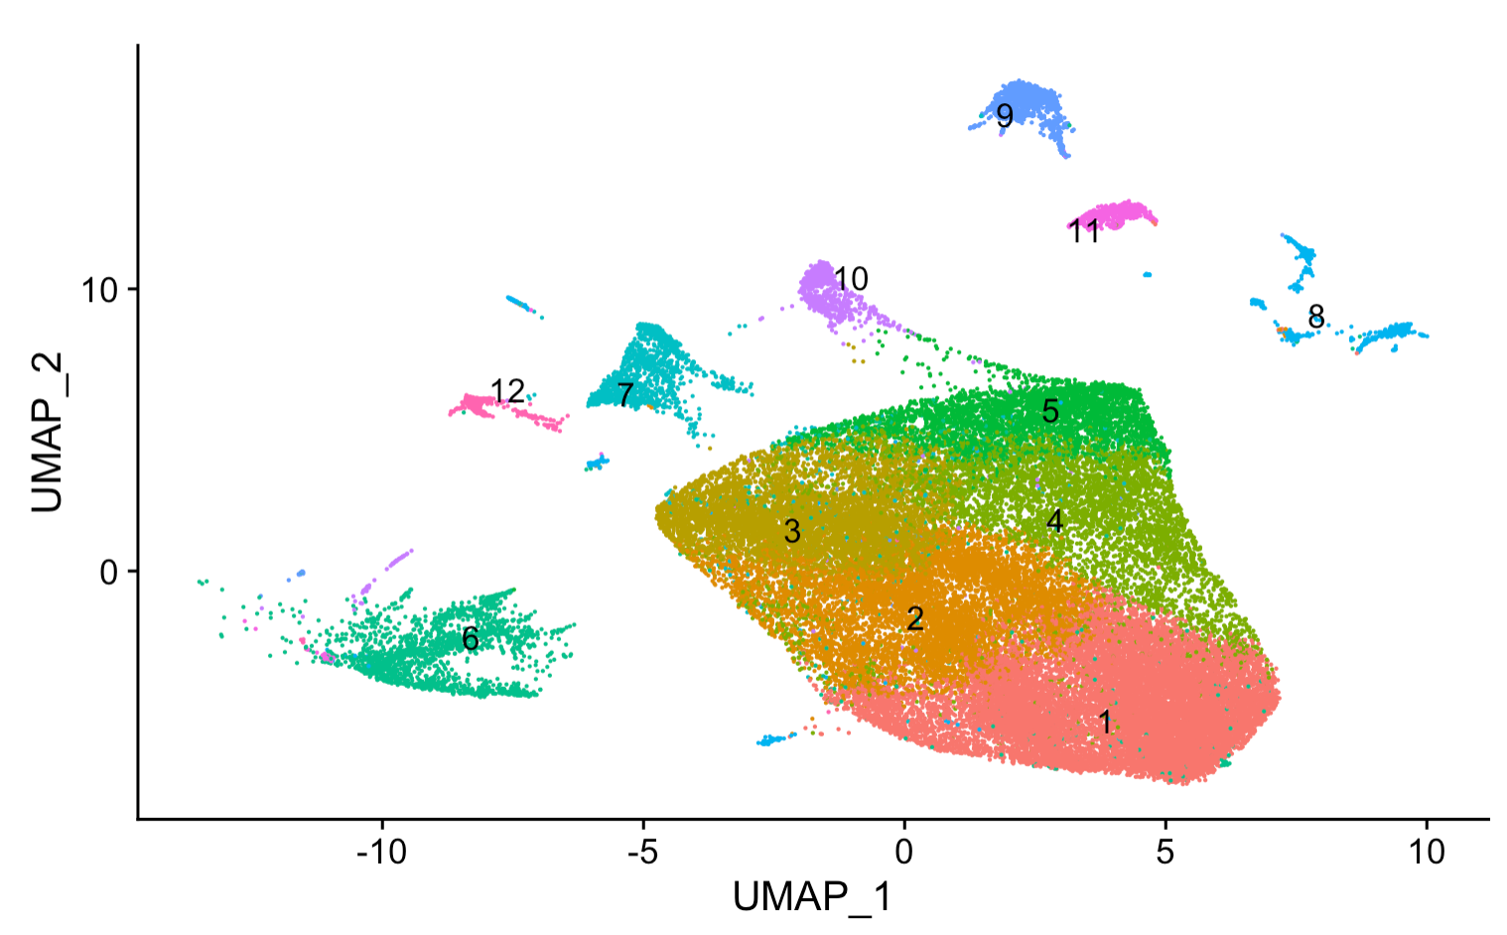
UMAP of Microglia cells – 12 subclusters

Slide 36
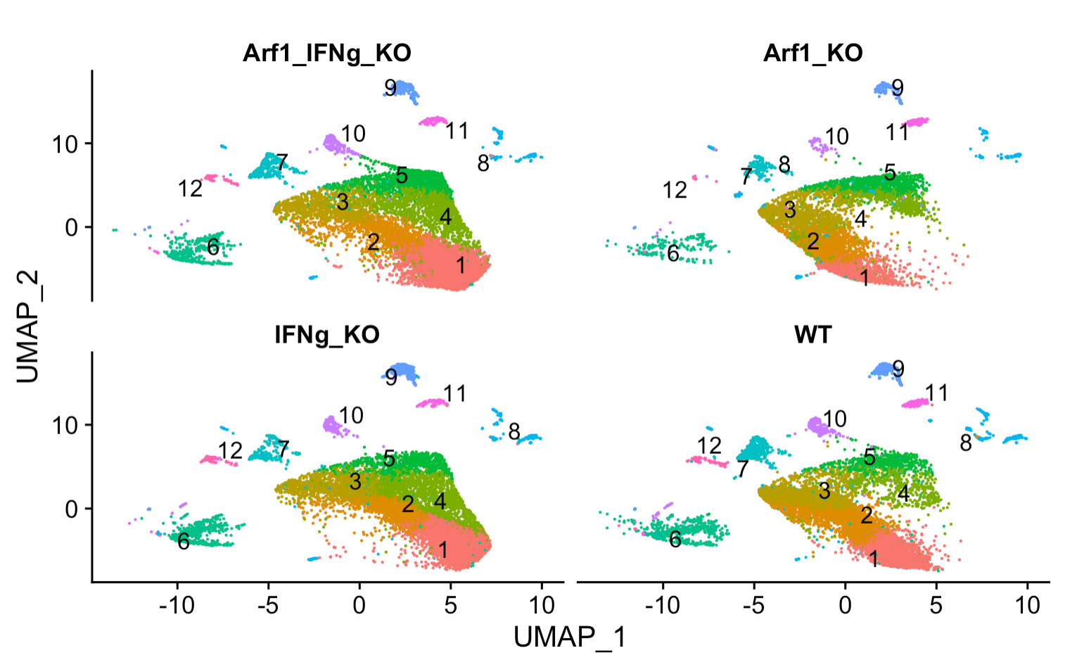
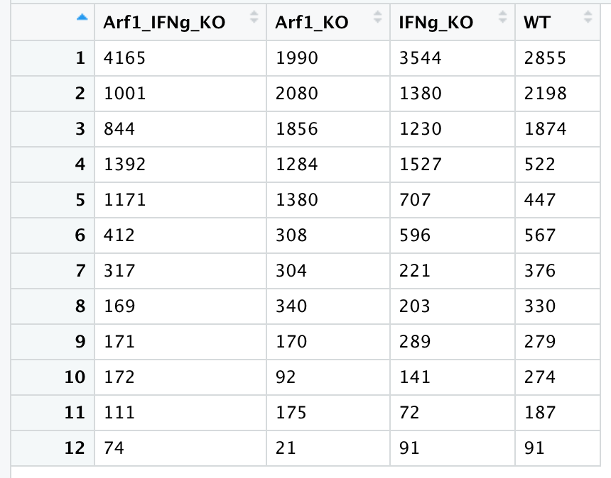
Only microglia cells – reshaped with 0.3 resolution into 12 microglia subclusters
Number of microglial cells for each cluster in each sample

Slide 37

Arf1_KO is enriched in Cluster 5 compared to three other samples
depleted
enriched
***
depleted
***
depleted
***
depleted
***
***
Chi-square test: P < 0.05 Sig
Notes:
cluster13.061809e-414.408523e-1171.463532e-211sigsigcluster25.324500e-021.578925e-373.133855e-97nsnscluster37.807314e-013.716381e-333.241908e-96nsnscluster42.514975e-802.984808e-063.437892e-02sigsigcluster52.295357e-1213.120161e-542.121216e-05sigsigcluster61.721496e-162.082738e-192.597737e-04sigsigcluster78.583888e-034.063192e-046.277701e-01signscluster87.407008e-015.617508e-093.288811e-14nsnscluster91.493100e-062.370031e-079.806000e-01signscluster101.039198e-173.695263e-037.801740e-06sigsigcluster115.981977e-013.197678e-112.528252e-04nsnscluster125.737170e-095.360490e-091.739415e-06sigsig

Slide 38


sig P = 2.30e-121
sig P= 3.06e-41
ns
ns
sig P= 2.51e-80

Slide 39

Markers (top 10 by average fold change) for each microglia subcluster

Slide 40
conditions | Model | Sequencing tech | source
multiple sclerosis | Mouse (EAE) | Nanostring | Kraseman et al., 2017
Amyotrophic lateral sclerosis (ALS) | Mouse (SODG93A) | Bulk RNA-seq | Chiu et al., 2013
Alzheimer’s disease (AD) | Mouse | Single cell RNAseq | Keren-Shaul et al. 2017
aging | mouse | Bulk RNA-seq | Holtman et al., 2015

Slide 41


Up-regulated disease genes

Slide 42


Down-regulated disease genes

Slide 43






Alzheimer’s disease (AD)
Amyotrophic lateral sclerosis (ALS)
aging
Signed.value = sign(logFC) * log10(Pvalue) * abs(logFC)
Disease
-
normal
Arf1 - WT

Slide 44




Top differentially expressed genes in Arf1-WT include some of the well-known neurodegenerative disease risk genes
multiple sclerosis
aging
Amyotrophic lateral sclerosis (ALS)
Alzheimer’s disease (AD)

Slide 45




Top markers in both Cluster 5 include some of the well-known neurodegenerative disease risk genes
multiple sclerosis
aging
Amyotrophic lateral sclerosis (ALS)
Alzheimer’s disease (AD)

Slide 46


WT cluster5-cluster1
Arf1 cluster5-cluster1
How similar are Arf1 cluster5 and WT cluster5 ?
Venn diagram here…
FC heatmap here…

Slide 47

Does cluster5 DEGs have an over-representation of neurodegenerative disease-associated genes?
***
***
***
***
Fisher’s exact test
*** P value <0.05

Slide 48

associated with late-onset Alzheimer's disease
Top markers for Cluster 5 include many known disease risk factors
An increase in expression from Cluster1 to Cluster5
Notes:
The most common gene associated with late-onset Alzheimer's disease is a risk gene called apolipoprotein E (APOE).

Slide 49

Top marker of Cluster 1 include mostly “microglial marker genes”

Slide 52


Top 500 most variable genes (mean expression) cluster1 - 5
PCA cluster1 - 5

Slide 53
Plot that shows Arf1 and WT cluster 5-1 degs are very similar (also INFg and Arf1_INFg)
Total of three to make: 1. Arf1-WT, Arf1-IFNg, Arf1-Arf1_IFNg, IFNg-WT, Arf1_IFNg-WT (venn diagram, find key genes). (biowulf swarm job) 2. FindAllMarkers 3. Cluster5 – Cluster1
Heatmap(up and down-regulated genes for Cluster5 – Cluster1, and Arf1-WT degs),
Heatmap of cluster1-5 to show clustering(most variable genes or all genes)
ORA for Arf1-WT
Frequency plot for disease genes and p values
Logistic regression trend through cluster1- cluster5

Slide 54
To do for Guohao
Look into myCluster5_cluster1_deg_ORA and decide which pathways to do dotplot, which ones to show network

Slide 55


Cluster5 - enriched pathways

Slide 56



Cluster5 - enriched pathways
From file: myCluster5_cluster1_deg_ORA

Slide 57

Arf1-WT differentially expressed genes volcano plot for each of the 14 microglia clusters
The consistant DEGs across clusters are in
Folder ”microgliaCluster_Arf1_vs_WT”

Slide 58


Up and down-regulated genes in Arf1 vs. all

Slide 59

Overlap of significantly over-represented processes in Arf1-WT for each microglial cluster

Slide 60


Most frequent biological processes in different sample comparisons

Slide 61

lipid metabolic process network
log

Slide 62

Differentially expressed genes in the lipid metabolic process
log

Slide 63

Differentially expressed genes in the lipid metabolic process – across samples

Slide 64


Differentially expressed genes in the lipid metabolic process – across samples

Slide 65



Examples of down-regulated and up-regulated genes in the lipid metabolic process

Slide 66

Only "Il1b","C1qa", "C1qb", "C1qc", "Stat1", "Nlrp3", "Casp1” are in microgliaReshape
“TNF” and "IL1a” are not in microgliaReshape

Slide 67

Enrichment map - enriched terms are organized into a network with edges connecting overlapping gene sets. In this way, mutually overlapping gene sets tend to cluster together, making it easy to identify functional module.

Slide 68
A common feature of neurodegenerative diseases is the presence of activated microglia in areas of neuronal death.
Amyotrophic lateral sclerosis (ALS) is a neurodegenerative disease characterized by progressive loss of motor neurons, leading to paralysis and death. Microglia activation occurs robustly in ALS patient tissue and in spinal cords of mutant SOD1 transgenic mice.
For comparisons of transcriptome changes in LDAM with published datasets
(Fig. 2g; Extended Data Fig. 3), we selected the following published RNA-seq
datasets of microglia in aging and neurodegeneration (modified after Bohlen et al.,
2017)56: 24-month versus 4-month-old wild-type mice for aging (Holtman et al.,
2015)22; APP+ versus APP– for Alzheimer’s disease (Wang et al., 2015)24; SODG93A
endstage versus nontransgenic day 130 for ALS (Chiu et al., 2013)23; DAM versus
homeostatic microglia (Keren-Shaul et al. 2017)3; MGnD versus homeostatic
microglia (Kraseman et al., 2017)4; and microglia clusters published by Li et al.,
(2019)5 and Hammond and colleagues (2019)25. For gene set comparisons, we
generated lists for the published datasets by using a fold change cutoff (modified
after Bohlen et al., 2017)56 and compared these lists with the top 100 upregulated
and downregulated genes in LDAM.

Slide 69


Slide 70



Notes:
The most common gene associated with late-onset Alzheimer's disease is a risk gene called apolipoprotein E (APOE)
TREM2 and APOE, two key
genes involved in the progression of neurodegeneration that are
upregulated in DAM and MGnD,
517

